Slide 1
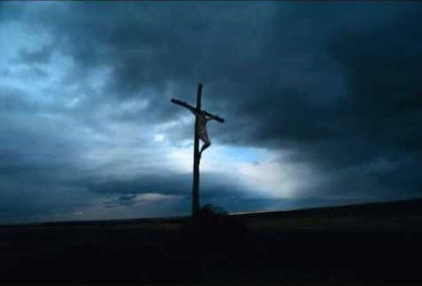
This Kingdom
Jesus - god's righteousness revealed The son of man, the son of god
His kingdom comes Jesus - redemption's sacrifice
Now glorified, now justified His kingdom comes
And this kingdom will know no end And its glory shall know no bounds
For the majesty and power Of this kingdom's king has come
And this kingdom's reign And this kingdom's rule
And this kingdom's power and authority
Jesus - god's righteousness revealed
Jesus - the expression of god's love The grace of god, the word of god
Revealed to us Jesus - god's holiness displayed
Now glorified, now justified His kingdom comes

