Slide 1
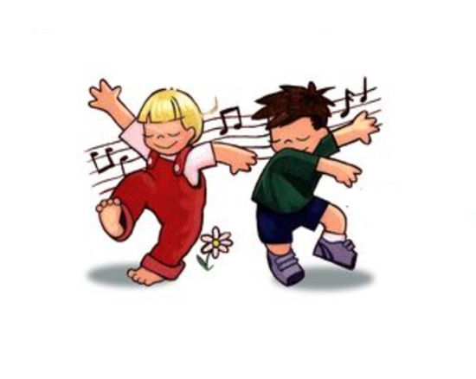
Joy Joy Down In My Heart
I've got the joy, joy, joy, joy down in my heart (Where) Down in my heart! (Where)
Down in my heart! I've got the joy, joy, joy, joy down in my heart Down in my heart to stay
I’ve got the peace that passes understanding Down in my heart (where?)
Down in my heart (where?) Down in my heart
I’ve got the peace that passes understanding Down in my heart (where?) Down in my heart to stay
I’ve got the wonderful love of my blessed Redeemer Way down in the depths of my heart (where?) Down in the depths of my heart (where?) Down in the depths of my heart
I’ve got the wonderful love of my blessed Redeemer Way down in the depths of my heart (where?) Down in the depths of my heart to stay
Refrain
And I'm so happy, so very happy I've got the love(peace) of Jesus in my heart
And I'm so happy so very happy I've got the love(peace) of Jesus in my heart

