Slide 1
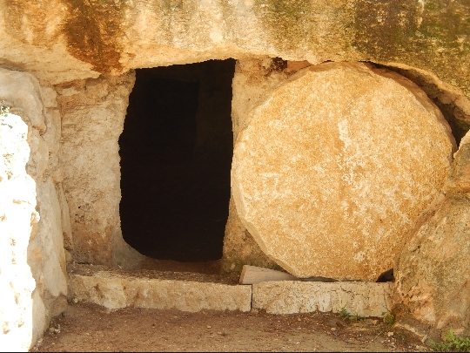
Jesus Is Alive
Hallelujah
Jesus is alive
Death has lost it's victory
And the grave has been denied
Jesus lives forever
He's alive! He's alive!
He's the Alpha and Omega
The first and last is he
The curse of sin is broken
And we have perfect liberty
The lamb of God is risen
He's alive, He's alive!

