Slide 1
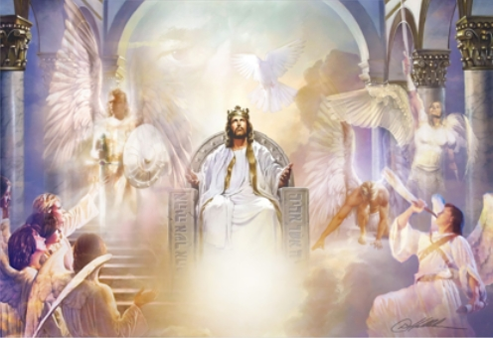
I see the Lord
I see the Lord
Seated on the throne exalted,
And the train of His robe
Fills the temple with glory
And the whole earth is filled
And the whole earth is filled
And the whole earth is filled
With His glory
Holy
Holy
Holy
Holy
Holy is the Lord

