Slide 1
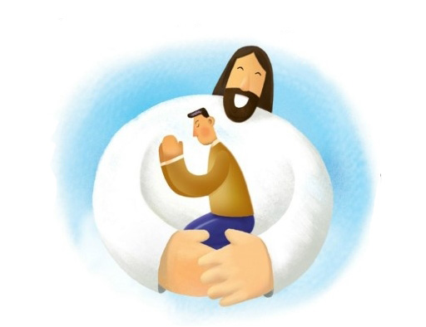
To Be Pleasing You
Lord I want to live my life
To please You
I bring my heart before You
To remold
Make of me a vessel fit for honor
That I might shine for You
As sparkling gold
To be pleasing You, pleasing You
This is all I really wanna do
To be pleasing You, pleasing You
This is all I really wanna do
Lord I lift my heart in full surrender
All that I hold dear I give to You
Purify my heart and make me holy so I might walk the way
That's pleasing You

