Slide 1
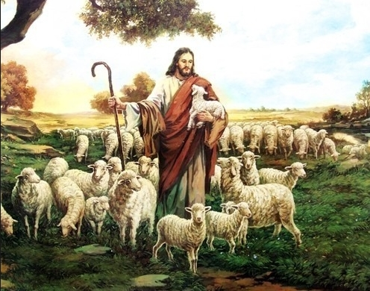
Shepherd of my soul
Shepherd of my soul I give You full control
Wherever You may lead I will follow
I have made the choice to listen for Your voice
Wherever You may lead I will go
Shepherd of my soul I give You full control
Wherever You may lead I will follow
I have made the choice to listen for Your voice
Wherever You may lead I will go
Be it in a quiet pasture or by a gentle breeze
The shepherd of my soul is by my side
Should I face a mighty mountain or a valley dark and deep
The shepherd of my soul will be my guide

