Slide 1
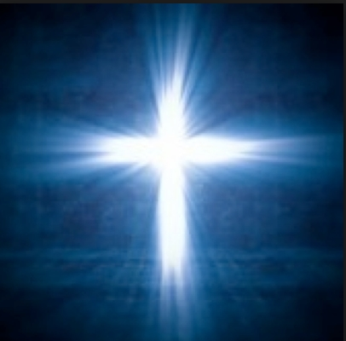
See His glory
See His glory, see His glory
See His glory now appear
See His glory, see His glory
See His glory now appear
God of light
Holiness and truth, power and might
See His glory, see it now appear
Now we declare our God is good
And His mercies endure forever
Now we declare our God is good
And His mercies endure forever

