Slide 1
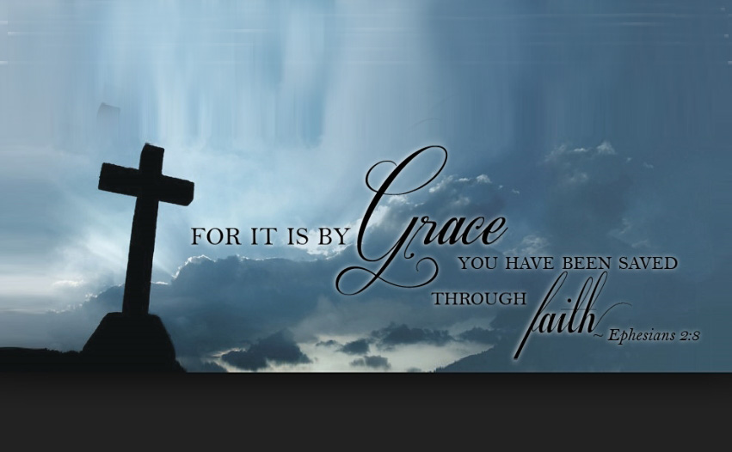
Only by grace
Only by grace can we enter Only by grace can we stand
Not by our human endeavor But by the blood of the Lamb
Into Your presence You call us You call us to come
Into Your presence You draw us And now by Your grace we come
Now by Your grace we come
Lord, if You marked our transgressions Who would stand
Thanks to Your grace we are cleansed by the blood of the Lamb(x2)

