Slide 1
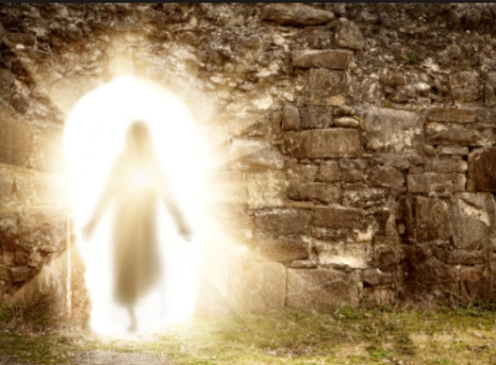
My best friend
Have you heard of the One called Savior?
Have you heard of His perfect love?
Have you heard of the One in Heaven?
Have you heard how He gave His Son?
Well I have found this love and I believe in the Son show me your way
I believe in the one called Savior
I believe He's the risen one
I believe that I'll live forever
I believe that the King will come
Because I have found this love and I believe in the Son show me your way
Jesus you are my best friend and you will always be Nothing will ever change that

