Slide 1
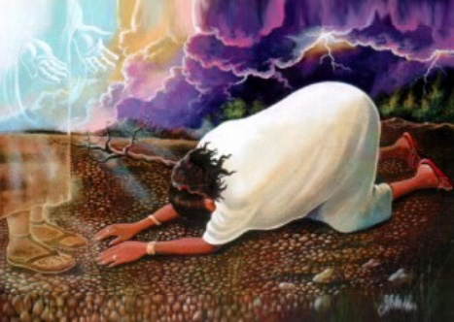
Jesus at your name we bow the knee
Jesus, at your name we bow the knee,
Jesus, at your name we bow the knee,
Jesus, at your name we bow the knee,
and acknowledge you as Lord.
You are the Christ
You are the Lord
Through Your Spirit in our lives
We know who You are

