Slide 1
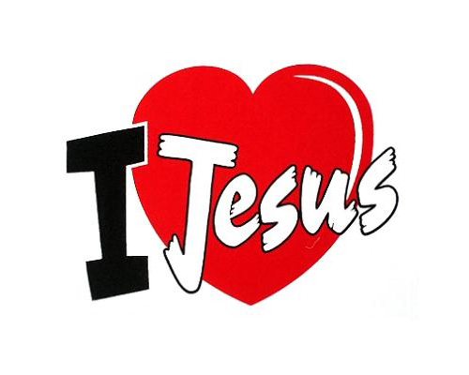
In Moments Like These
In moments like these I sing out a song
I sing out a love song to Jesus
In moments like these I lift up my hands
I lift up my hands to the Lord
Singing, I love You, Lord
Singing, I love You, Lord
Singing, I love You, Lord
I love You

