Slide 1
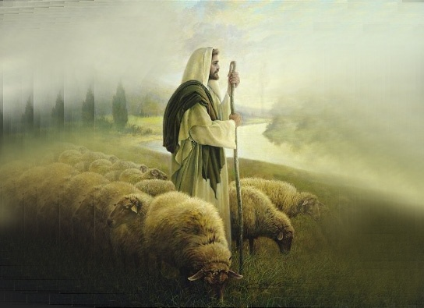
Everyday
What to say, Lord? It's You who gave me life
And I can't explain just how Much You mean to me now
That You have saved me, Lord I give all that I am to You
That everyday I could Be a light that shines Your name
Everyday, Lord I'll learn to stand upon Your word
And I pray that I I might come to know You more
That You would guide me In every single step I take that
Everyday I can Be Your light unto the world
Everyday, it's You I live for, Everyday, I'll follow after You
Everyday, I'll walk with You my Lord.
It's You I live for everyday!

