Slide 1
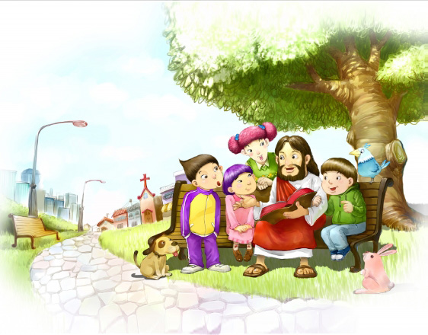
Alleluia (Jesus I love you)
Jesus, I love You
I bow down before You
Praises and worship
To our King
Alleluia, alleluia
Alleluia, allelu

