Slide 1
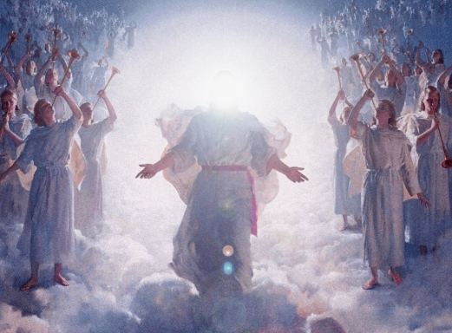
Until the Lord Returns
'til the Lord comes back - to the world
I will go on this way
narrow gate, narrow road, I will bear my holy cross
At the end of way that I'm going on
I will see the Lord, my majesty
Holy God, Glorious God
He comes out to welcome me
'till the Lord comes back - to the world
I will stand up strong and run till the end
When the glory covers all the land
I will stand up tall and praise the Lord
Lord, my longing majesty
You're the God, the savior God
Lord, my longing majesty
You're the king of all the earth.

