Slide 1
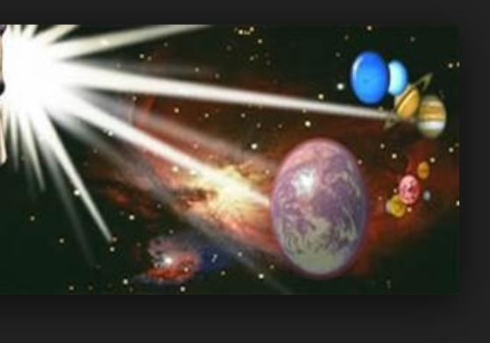
Nothing Is Impossible
Through You I can do anything
I can do all things Cause it's You who give me strength
Nothing is impossible Through You
Blind eyes are opened Strongholds are broken
I am living by faith Nothing is impossible!
I'm not gonna live by what I see
I'm not gonna live by what I feel
Deep down I Know that You're here with me
I know that, You can do anything
I believe, I believe I believe, I believe in You

