Slide 1
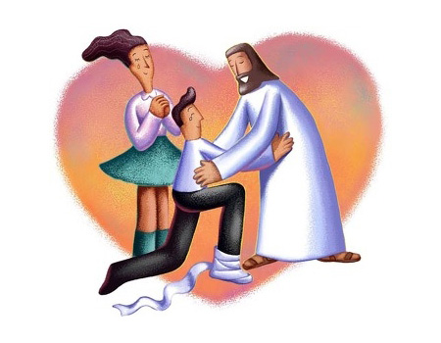
MY LIFE IS IN YOU LORD!
My life is in You, Lord My strength is in You, Lord
My hope is in You, Lord In You, it's in You
I will praise You with all of my life
I will praise You with all of my strength
With all of my life, with all of my strength
All of my hope is in You

