Slide 1
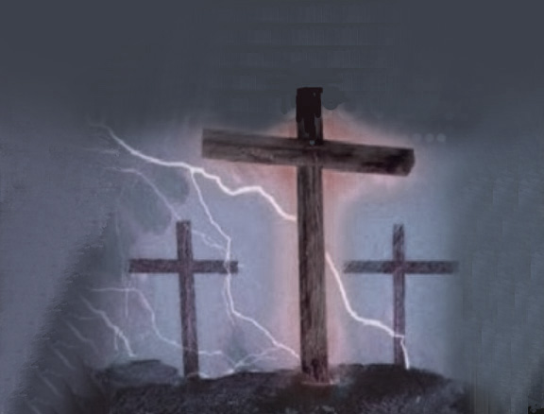
Unending Love
There's no silver or gold And no treasure untold
That could draw me away from Your heart
Neither love of myself Or of anyone else will do
Jesus nothing compares To this grace that rescues me
Savior now and forever Your face is all I seek
Now all I am I lay at Your feet
I'm humbled by the wonder of Your majesty
One thing I know I find all I need
In Your unending love In Your unending love Your love, Jesus
Letting go of my pride I lay down my desires
Just to worship in Spirit and truth More than all of my dreams
More than fame I will seek You Lord

