Slide 1
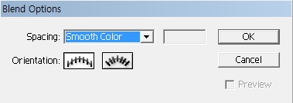
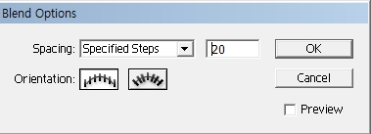
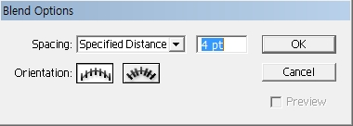
To design by using illustrator blend tool
Blend Option
Spacing: Determines how many steps are added to the blend.
Smooth color:
Lets Illustrator auto-calculate the number of steps for the blends. If objects are filled or stroked with different colors, the steps are calculated to provide the optimum number of steps for a smooth color transition. If the objects contain identical colors, or if they contain gradients or patterns, the number of steps is based on the longest distance between the bounding box edges of the two objects.
Specified step:
Controls the number of steps between the start and end of the blend.
Specified distance:
Controls the distance between the steps in the blend. The distance specified is measured from the edge of one object to the corresponding edge on the next object (for example, from the rightmost edge of one object to the rightmost edge of the next).
Orientation: Determines the orientation of blended objects.
Align to Page : Orients the blend perpendicular to the x axis of the page.
Align to Path : Orients the blend perpendicular to the path.

Slide 2
To design by using illustrator blend tool
Blend Tool
-To create and distribute shapes evenly between two objects
To create an intermediate stage of the two or more objects
Object> Blend> Make
-Or you can click the objects and apply to them by blend Tool.
1. Fill color: Yellow, Stroke color: Red Stroke Weight:2 pt> Choose Type>Write KOREA
2. Choose KOREA >Type> Create outline
3. Choose KOREA >Press Alt key ,then can get KOREA copy >can move KOREA copy properly
Or choose KOREA copy >right mouse click>Arrange>send to back
4. Select KOREA and KOREA copy> Object> Blend> Make
5.Click Blend Tool twice>Blend Option
If intermediate stage is one color, click Spacing
>Choose Specified step>
value: Choose around 20
or from 10 to 30>OK

Slide 3
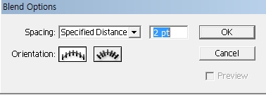
To design by using illustrator blend tool
1.Fill color: Black, Stroke color: Yellow Stroke Weight:1 pt>
Choose Type>Write US EVENT
2. Choose US EVENT >Press Alt key,then can get US EVENT copy >
No Stroke color, Fill color: Yellow
Select US EVENT copy >Object> Arrange> Send to back
3. Choose US EVENT and US EVENT copy >Type>Create Outline>
Choose US EVENT and US EVENT copy >Object>Group
4. Choose US EVENT and US EVENT copy >Blend tool twice click>
Blend Option > Spacing: Specified distance : 2pt >OK
5. Choose US EVENT and US EVENT copy > Object> Blend> Make
6.Click Lasso tool> Click the above word US EVENT> Change word shape by using selection tool, free transform tool

Slide 4
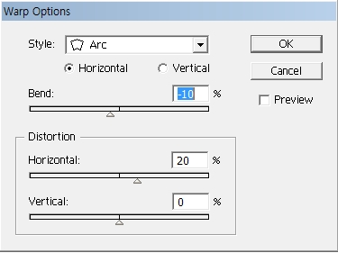
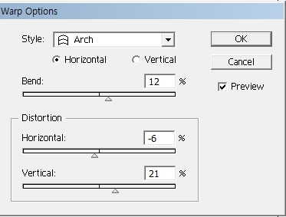
To design by using illustrator blend tool
7. Choose US EVENT and US EVENT copy> Object> Envelope Distort> Make with Warp> Select Style, Change Bend value, Distortion value>Create letters that you want to make
Can change letter shape by Checking Preview >OK

Slide 5
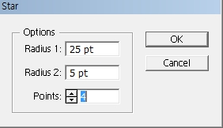
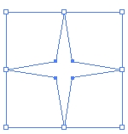
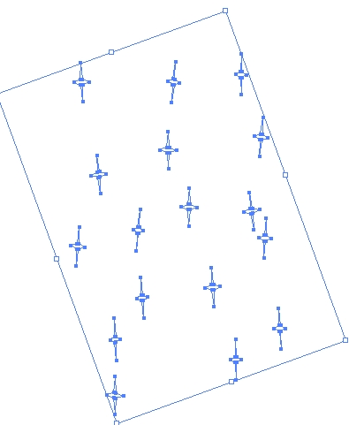
To design by using illustrator star tool
Fill color: white Stroke color: No
Select Star in the Rectangle tool>If u press Alt key one time, the star dialog box will appear. Radius1:25pt, Radius2: 5pt, Points:4>OK
2. Click this shape >Press Alt key,
then u can get star copy>
Repeat several times>
Can get many stars

Slide 6
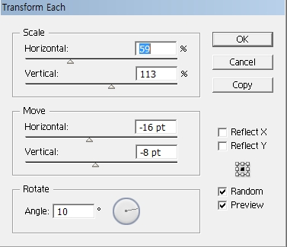
To design by using illustrator star tool
3.After choosing all stars >Object> Transform>Transform Each >
Change Scale, Move, Rotate value> Check Random, Preview>OK
4. Click Rectangle tool> Fill color: Night Sky color/ No stroke color,
make a Rectangle> Choose a Rectangle>Object>Arrange>Bring to front

Slide 7
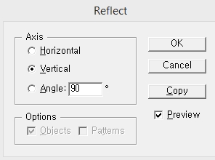
Creating a Ladybug by illustrator
Fill color: Red Stroke color:Black> Making Red elytron by ellipse Tool> Fill color: Red Stroke color:Black Making 4 black spots on elytron(wing cover)
2. Fill color: Black Stroke color: Black, Making a black pronotum and head by ellipse Tool> Fill color: white Stroke color: Black Making white an eye by ellipse Tool> Fill color: black Stroke color: Black Making a black pupil by ellipse Tool
Click both the eye and the pupil> Press Alt key, then can get copy> Move them properly
By pen tool draw one antenne>Choose the antenne>
Choose reflect tool>Click alt key and the reference point at the same time>Click vertical, record, check preview, click copy >OK

Slide 8
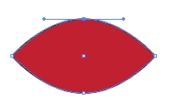
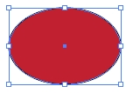
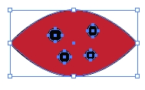
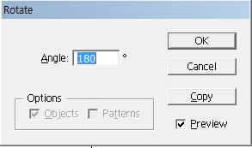
Creating a Ladybug by illustrator
4. Draw three legs by pen tool >After choosing the legs, click the Reflect tool >Click Alt key and the reference point at the center of red elytron(wing cover),then the reflect dialog box will appear.Click vertical, record, check preview, click copy >OK
5. If you want to create the ladybug which spread wings>By ellipse Tool,
make one red round elytron (wing cover) on body>By using convert anchor point, Click both sides >Make like this picture
6. Draw 4 spots in the red elytron (wing cover) by ellipse Tool > Click the
red elytron and 4 spots >Choose Rotate tool>Press Alt key and the
reference point at the same time, then the rotate dialog box will appear.
7. On Rotate dialog box, record angle 180> Click copy, then can get the wing cover with 4 spots copy

Slide 9
Creating a Ladybug by illustrator
8. Make a pronotum on a black body by ellipse Tool>Choose the pronotum >
Object>Arrange>Send to back
Make a head on a black pronotum by ellipse Tool> Choose the head>
Object>Arrange>Send to back
Draw an eye and a black pupil by ellipse Tool> Choose one eye and pupil >Press Alt key, then can get copy and move them properly
9. By pen tool, draw 2 antenne and 6 legs
10. By ellipse Tool, draw 2 wings, Choose 2 wings > Object>Arrange>
Send to back

