Slide 1
illustrator
CMYK : Dyes (Paint) color model, printing, Use when printing
RGB : Additive mixture to show light mixed. Color for a web by monitors
ILLUSTOR AI :The default file extension of illustrator
ILLUSTOR EPS :The file extension that optimizes for printing illustrator files
Vector image :
This represents the image by mathematical function relation connecting
the point and the point,so creates the lines and planes. It represents the
image using a line and a curve, including color and position properties
. Image with a line. Because making straight and curved form by a
mathematical formula, Even though it is zoomed in or out, it does not
break the image. The capacity is low, modifications come easily.
Bitmap images:
It represents the image by dots of the small squares, called "pixel".
Higher the resolution, the more the number of pixels it means:
the size of the particles. The lower resolution, the smaller number of
pixels

Slide 2
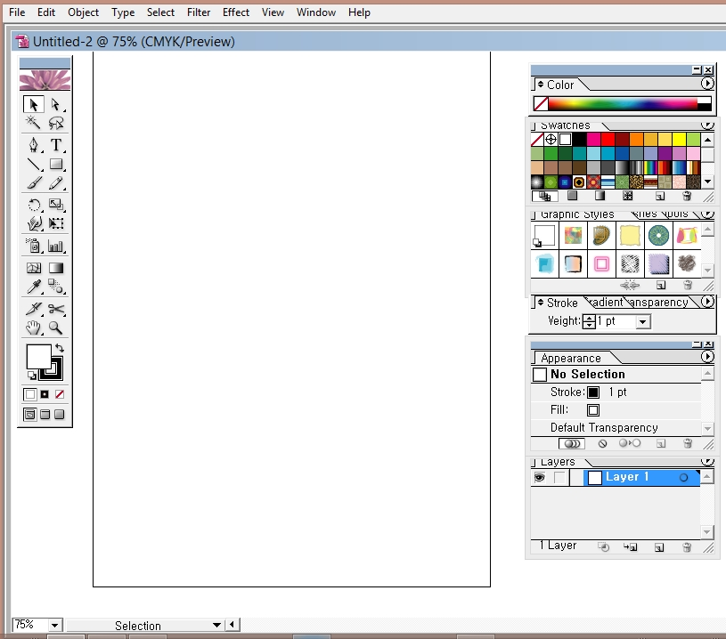
Illustrator Tutorials
Menu
Palette
Toolbox
Artboard:
Drawing Area
STROKE:
Line thickness
layer
Magnification
Status bar

Slide 3
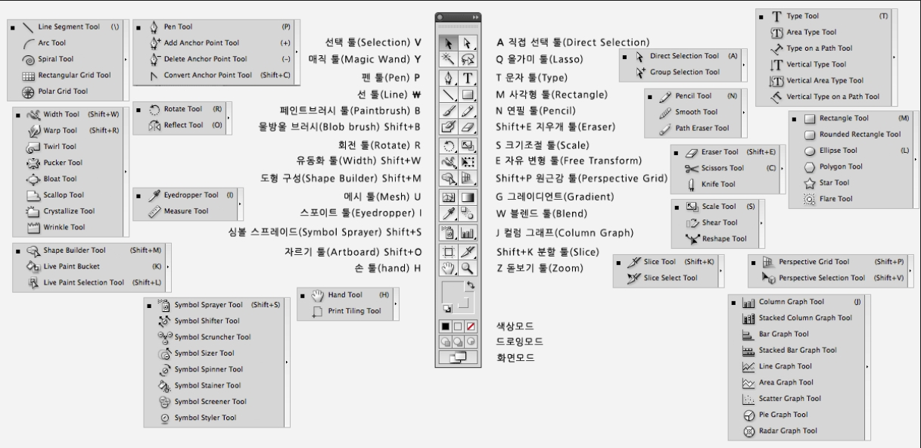
Illustrator Toolbox

Slide 4
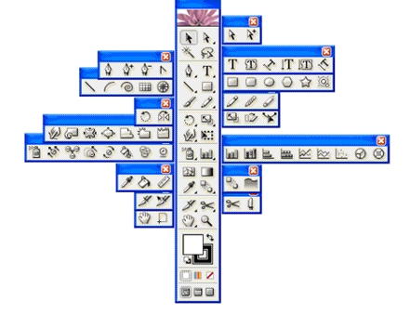
Illustrator Toolbox
Selection tool: selection
Direct Selection tool :
Partial-select of grouped object,
group selection
Magic wand tool: Similar properties selection
Lasso tool: As dragging the reference point , line selection
Pen tool: Making the object using Free-form lines, Bézier Curve
type tool, Area type tool, Type on a path tool, Vertical type tool, Vertical area type tool ,
Vertical type on a path tool
Line segment tool: straight line, curve, spirals, circle , grid
Paintbrush tool
Rectangle tool:
Rounded Rectangle tool, Elipse tool, Polygon tool, Star Tool, flare tool
Rotate tool, reflect tool
Warp tool :
Distortion deformation
Twirl :
Pucker tool: wrinkle
bloat tool :
Expansion tool
Scallop:fan-shape tool Crystallize:
Wrinkle:
Pencil tool: use drawing free curve
Smooth tool , Path eraser tool
Scale, Shear,
reshape tool
Gradient
Graph
Symbol sprayer tool :
symbol application / editing
Blend tool, auto trace tool
Represent an intermediate step changing the object and the object , Automatic tracking tool
Mesh tool
Reference point arrangement like network
Eyedropper tool ,paint bucket tool, measure tool
Scissors tool: Separation by choosing a reference point
Slice tool: Split image
Zoom tool: Zoom In, Zoom Out, workplace regulation control
Hand tool: move

Slide 5
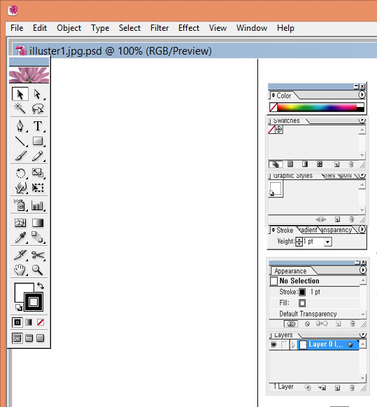
Illustrator pen tool use
1. Pen tool:
Use drawing a freeform
Creating an object or Bézier Curve
Adjustment form
Pen tool/ Add anchor point tool/ Delete anchor point tool / Convert anchor point tool
2. Adjustment of the reference
point direction of the pen tool
In the path operations, affected by the front direction line, When not removing the direction line, taking a reference point, then the curve is drawn. When you want to draw a curve of another angle or a broken straight line, you must delete the front direction line.
3. Drawing Bézier Curves
-Drawing a straight line:
Click the part of a broken straight line, then make a point and a segment and draw.
- Drawing a diagonal line:
Create the point by clicking the starting
point, if holding down the SHIFT key, click on
the broken part, you can draw a 45-degree
angle. - Drawing curves:
With clicking a broken part, after clicking the starting point and creating a point, by dragging to the right, if a direction line appears on the point, draw a curve.
Pen tool
Fill color
SWAP
change in color
Stroke color
if you want to make the fill color transparently, Click here
DEFAULT
COLOR
WHITE,BLACK

Slide 6
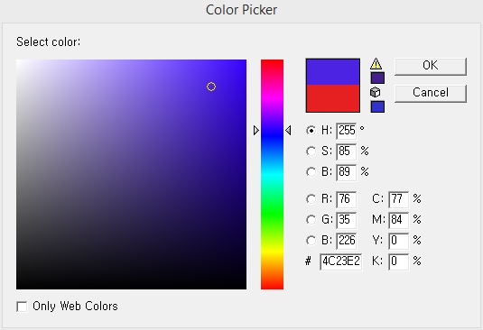
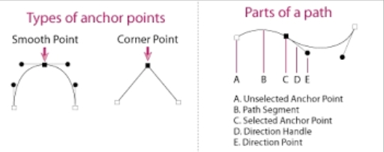
Illustrator pen tool use
Current color
Previously-selected color
1. Fill color and stroke color:
Adjustment of color saturation,
and brightness in the Color Picker
after double-clicking the Fill color and Stroke color window
2. Color Palette:
Color Mixing,Color Mode,changeable
1. Zoom In : zoom tool, or CTRL+ (+) Magnification
2. Zoom Out : CTRL+ ( -)
3. When you want a new line : Press CTRL key and deactivate and deselect
make a new line.
4. Drawing curves : Need to drag upward, press CTRL Key and make a correction,
If you want to change direction lines : Press ALT Key
5. Direction point:
Part which move the direction lines and adjust a curve shape 6. Direction line :
Curve slope and bend adjustment

Slide 7
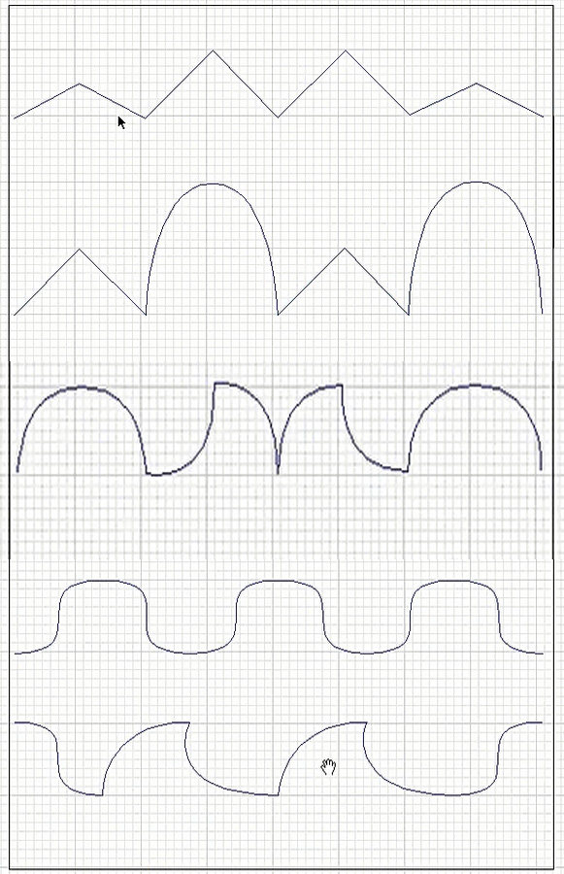
Practice using illustrator pen tool

Slide 8
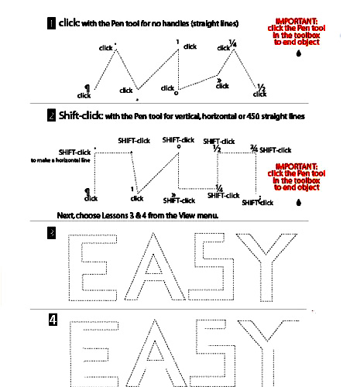
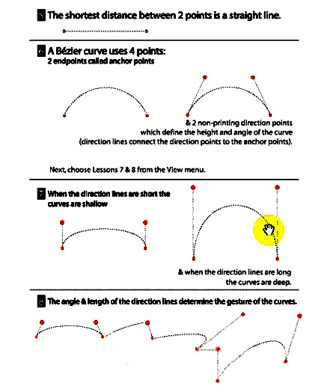
Practice using illustrator pen tool

Slide 9
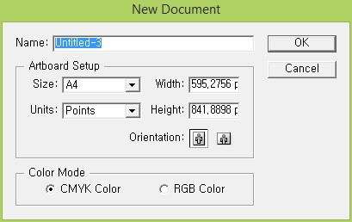
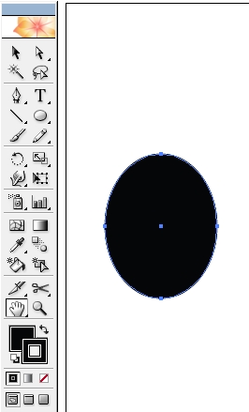
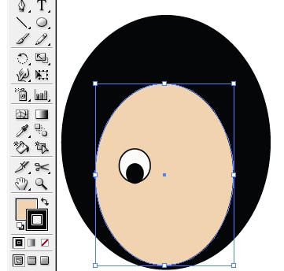
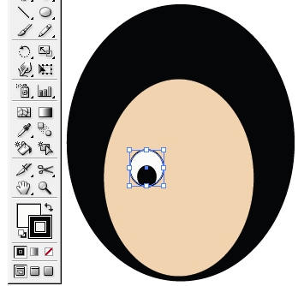
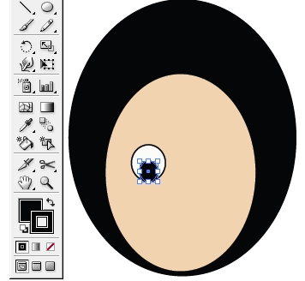
Creating a simple character by illustrator
1. File> NEW
Name, Size; A4, Width,Height value,
Orientation: Choose one among Horizontal and Vertical
2. Fill color:Black, Stroke color: Black>
Choose Ellipse tool >Draw an oval shape’s head
3. Choose Ellipse tool >Draw an oval shape’s face
Fill Color: incarnadine> Draw an oval shape’s eye Fill Color: White> Draw an oval shape’s pupil
Fill Color: Black

Slide 10
Creating a simple character by illustrator
4. Draw eyebrows by pen tool> Choose eyes and eyebrows>
After grouping this as Ctrl+G >Choose Reflect tool> Press Alt key
Decide a reference point > Vertical, Copy
Or Choose eyes and eyebrows>Right mouse >
Transform>Reflect>Copy >
Move object position properly
5. Click Ellipse tool and press down Alt key at the same time. Draw a mouth(If want to draw circles from the center>Press Alt key)
If want to change mouth shape>Choose Convert Anchor Point tool in the Pen tool> Click this red parts of Oval >
Choose Delete Anchor Point> Click a part>
Choose mouth color and fill in the mouth
a

Slide 11
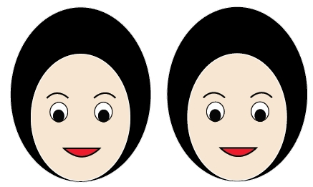
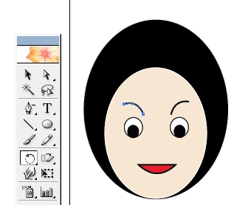
Creating a simple character by illustrator
6. Choose this all face>
Copy the same character by pressing ALT key
When you press the Alt key, pressing the shift key, you can make Horizontal Copy
or Edit>Copy>Paste
Or
After Choosing Object to copy >Choose Reflect tool > Decide a reference point and
Angle value> Copy
7.To transform this face shape>Choose eyebrows>Click Rotate tool>
Select a point on the bottom of the eyebrows which will be reference
points>Drag to rotate eyebrows>Apply the same method to other
eyebrows

Slide 12
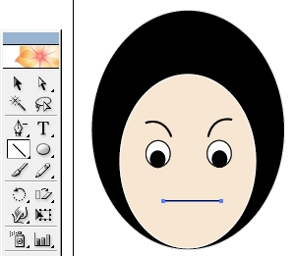
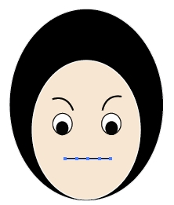
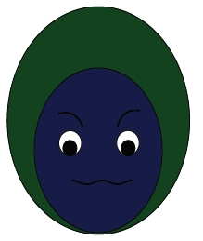
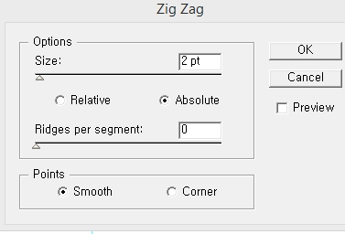
Creating a simple character by illustrator
8. First, erase the mouth which drew>For drawing a new mouth, Choose
Line> Draw the mouth as a horizontal line (To draw horizontal line lips:
Choose line tool+Shift key) > Select mouth>Object>Path>Add
about two Anchor points
9. In the Lip added Anchor Points>Filter>distort>Zigzag>Size:3pt, Ridges
per segment:0,Point:Smooth>OK>Choose lips and move appropriately,
Change face color and hair color

Slide 13
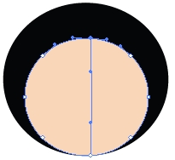
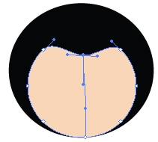
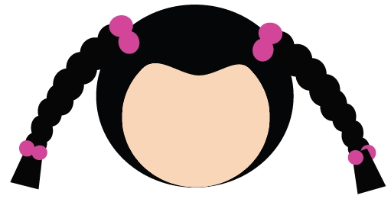
Creating a character by illustrator
1. File>New, stroke color:Black
2. Choose Ellipse tool> Fill color:Black Stroke color:Black, Draw a head> Fill color:incarnadine Stroke color:Black, Draw smaller face than a head>Click Mesh tool and then click the face> choose an anchor point and move that anchor point> Draw pigtails and headband by ellipse tool, draw the end of pigtails by pen tool
After grouping this as Ctrl+G >Choose Reflect tool> Press Alt key
Decide a reference point > Vertical, Copy
Or Choose pigtails and headband>Right mouse >
Transform>Reflect> Copy >
Move object position properly

Slide 14
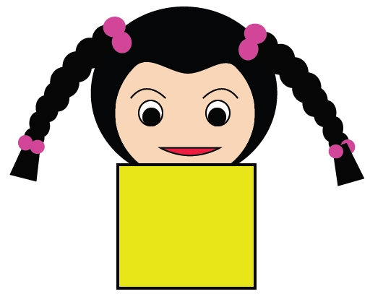
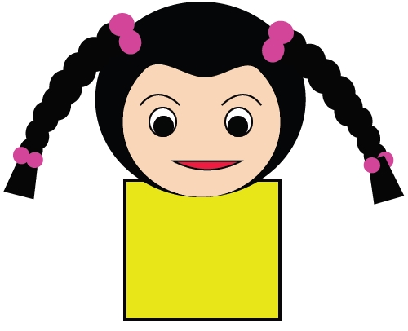
Creating a character by illustrator
3. Fill Color: White, Draw an oval shape’s eye by Ellipse tool >
Fill Color: Black, Draw an oval shape’s pupil by Ellipse tool
Draw eyebrow by pen tool> After grouping this eye and pupil
and eyebrow as Ctrl+G >Choose Reflect tool> Press Alt key
Refer the previous page for making lips
Select the color you want and make one body by Rectangle tool, Stroke color: Black, weight appropriately
4. For sending body to back from face.> Choose body>Right mouse >
Arrange> Send to back face

Slide 15
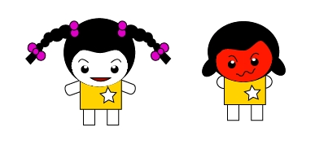
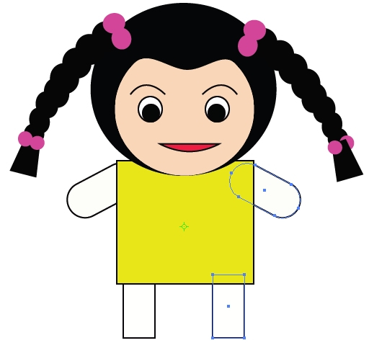
Creating a character by illustrator
5.Draw arms by Rounded Rectangle tool, Draw legs by Rectangle too
Choose both arm and leg>Choose Reflect tool> Press Alt key
Decide a reference point > Vertical, Copy
For sending arms and legs to back from body>Choose arms and legs>
Right mouse>Arrange> Send to back,
Choose star tool> Draw one star in body

