Slide 1
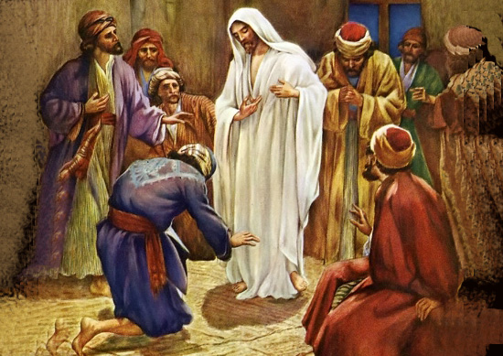
My Lord My God
My Lord, my God
My Lord, my love
I pledge my life to You
I’ll go Your way come what may
I surrender to You
I vow to always be true
To hold on to You ’til the end
Jesus, glory to You
My Savior, my King and my friend
My Lord, my God
My Lord, my love
My heart belongs to You
I’ll bring my hopes, here are my dreams
Yet I surrender to You

