Slide 1
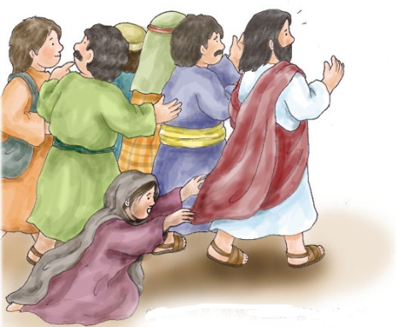
Enough
All of You is more than enough for all of me
For every thirst and every need
You satisfy me with Your love
And all I have in You is more than enough
You are my supply My breath of life
And still more awesome than I know
You are my reward worth living for
And still more awesome than I know
You’re my sacrifice Of greatest price
And still more awesome than I know
You’re the coming King You are everything
And still more awesome than I know
More than all I want More than all I need
You are more than enough for me
More than all I know More than all I can say
You are more than enough for me

