Slide 1
Making main page by using Pen Tool

Slide 2
Making main page by using Pen Tool
Resolution: width pixels x Height pixel
1366 X 768, 1280 X 768, 1280 X 720
1280 X 600, 1024 X 768, 800 X 600
600pixel
1280 pixel

Slide 3
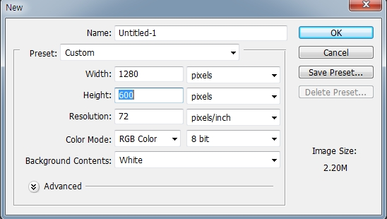
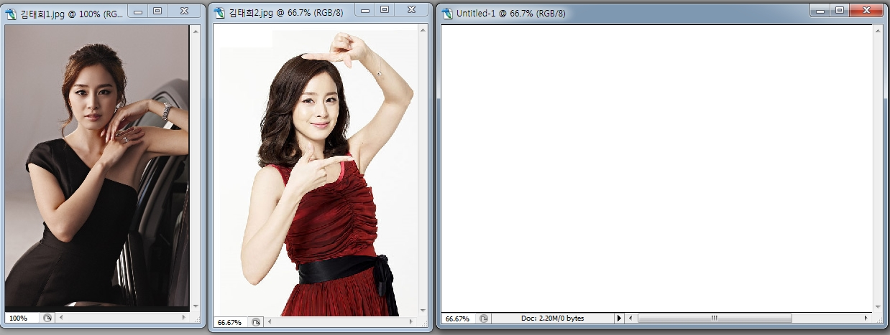
Making main page by using Pen Tool
File>New>Width: 1280pixel Height: 600Pixel>OK
File>Open >2 Pictures Open
3 screens opened.

Slide 4
Making main page by using Pen Tool
2. On the bottom of the screen which is opened newly, after making the area using the Rectangular marquee tools, put the color by using paint bucket tool

Slide 5
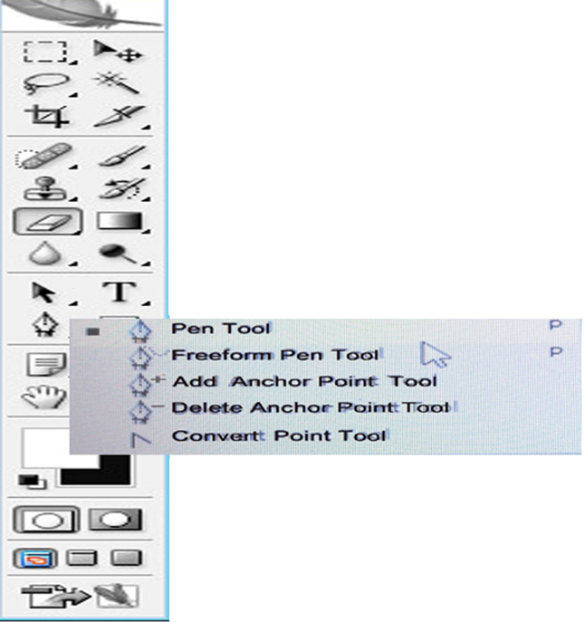
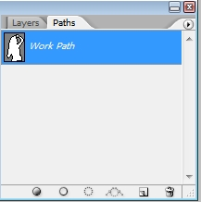
Making main page by using Pen Tool
3. Choose this path and Exclude overlapping path areas.
By using pen tool, choose Kimtaehee’s body. And then go to path.
Choose workpath+Control> Ctrl+ C
On the new screen, Ctrl+ V

Slide 6
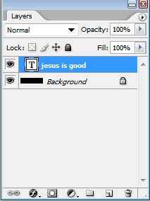
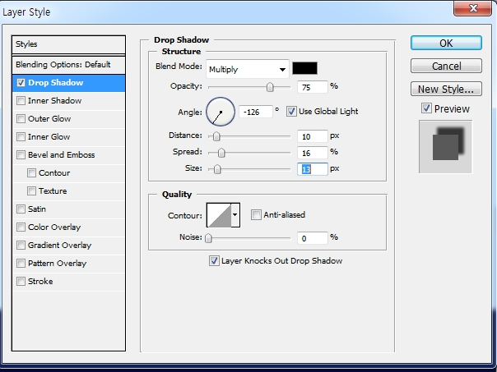
Making main page by using Pen Tool
4. If want to put the drop shadow of Kimtaehee picture> Click this Add a layer style >
Click Drop Shadow >Blend mode: Multiply> Control Angle, Distance, Spread, Size>OK

Slide 7
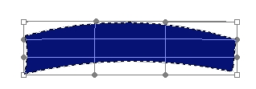
Making main page by using Pen Tool
5. How to make this?
Draw one rectangle by using Rectangular Marquee tool >
Put the color by using Paint bucket tool
6. Choose >Edit >Transform>Warp> Use Custom, choose Arc bend or Move the point properly

Slide 8
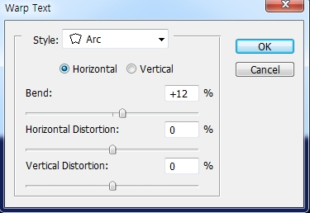
Making main page by using Pen Tool
7. Draw this by using pen tool and put the color>
Click T > Write
ON THE LAST CHANCE LAYER> CTREATED WARPED TEXT>
STYLE: ARC> CONTROL bend Value>OK

Slide 9
Making main page by using Pen Tool
Choose this by magic wand tool,
Ctrl +c> Ctrl +v > Then copied the same ribbon shape>
Move the copied ribbon at the proper place
by using move tool>
Choose the moved ribbon>edit>transform>
Choose flip horizontal> Trim ribbon shape properly

