Slide 1
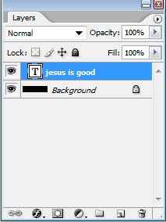
Writing your letters to complete the image
1.FILE> New> Width, Height,Resolution,Color Mode, Background Contents
2. Click Type tool, when recording type layer layer is created.
Type
Align
Type color
Create
warped text
Font size
font
type layer

Slide 2
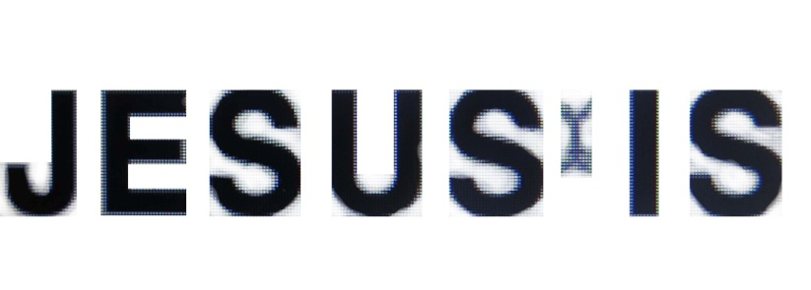
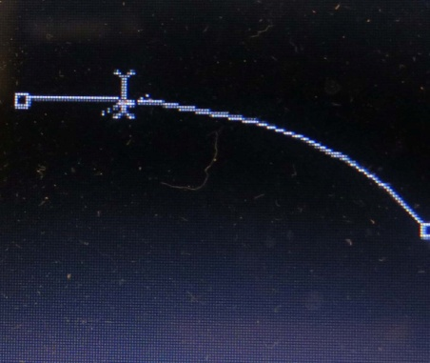
Writing your letters to complete the image
3. When recording type, the shape of mouse pointer
Type tool Mouse pointer indicates text will be edited on the place where the text is
Mouse pointer shape of Creating Text Along Paths
Type tool Mouse pointer indicates text will be created inside the shape
Type tool Mouse pointer indicates a new text will be created

Slide 3
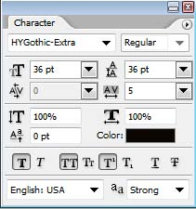
Writing your letters to complete the image
font
font style
Font size
Leading controls the amount of space between lines of types
Kerning: Kerning controls the space between two specific letters or characters
Tracking: another type
option found only in the Character panel, controls
the amount of space between a range of
letters or characters.
It's located directly below
the Leading option and is
set to 0 by default:
Vertical And Horizontal Scale
Baseline Shift: Baseline Shift allows us to move selected characters or words above or below the font's baseline.
Superscripts
Bold
Underline
Color
Upper, lowercase Change
Italic
subscript
Strikethrough

Slide 4
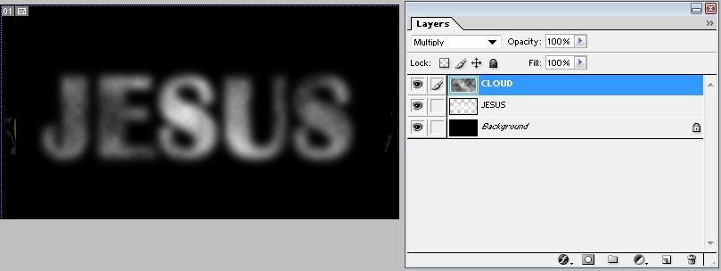
Constructing STONE material Text
FILE> New
Background color: Black( ALT+DEL)
Write character , control character size, character position properly
On the character layer>Right mouse click> Rasterize Type
On the character layer> filter>blur> Gaussian Blur> Radius: Around 10
Above the character layer>Make a new layer> On a new layer > Foreground: Black Background:white
On the new layer> Filter>Render>Cloud >Ctrl+F>Choose Cloud shape
On the new layer> Filter> Blur> Gaussian Blur> Radius: Around 10 >On this layer>Mode: multiply

Slide 5
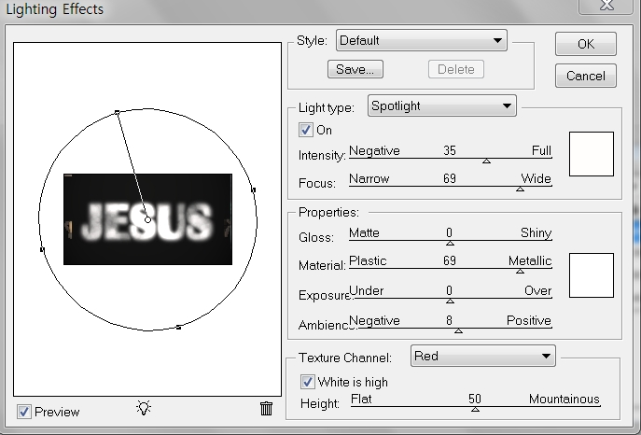
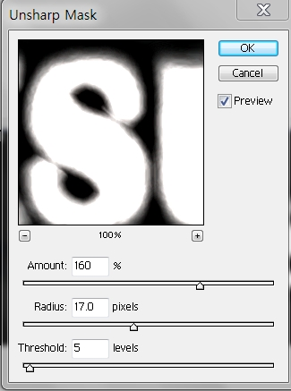
Constructing STONE material Text
CTRL+A : Cloud layer image Choice
CTRL+SHIFT+C(3Layers merged)> CTRL+V
Choose a new copied layer
On the new copied layer> Filter>Other>Maximum radius: Around 5
On the new copied layer >Filter>Render>Light Effects…
Texture channel: Red , Control lighting>OK
On the new copied layer> Filter> Sharpen>
Unsharp mask Amount 160 Radius 17
Tread 5>OK

Slide 6
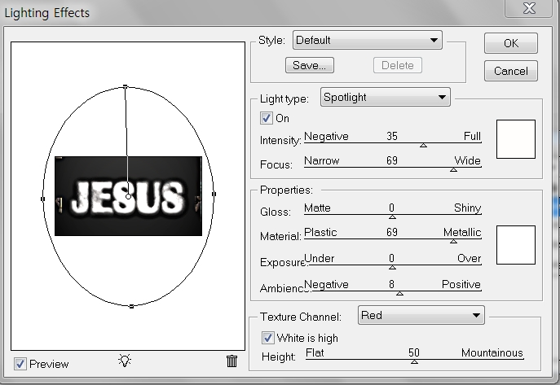
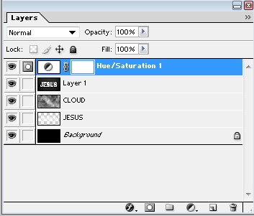
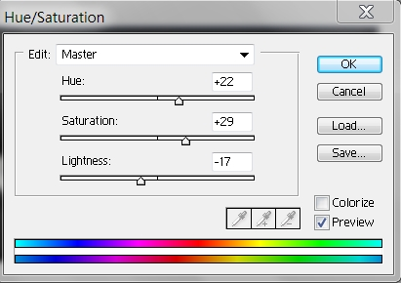
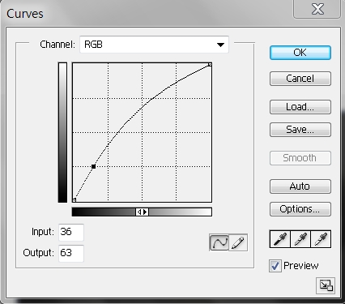
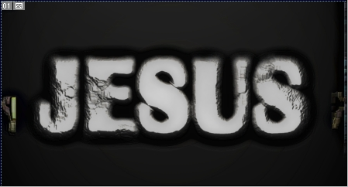
Constructing STONE material Text
For looking solid one more>Filter>Render>
Light Effects> Texture channel: Red
Control lighting>OK
Opacity: 80%
For coloring, click the create a new fill
Choose Hue Saturation
Hue 22
Saturation 29
Lightness -17
80%
Layer>New adjust layer>Curve>
Control properly

