Slide 1
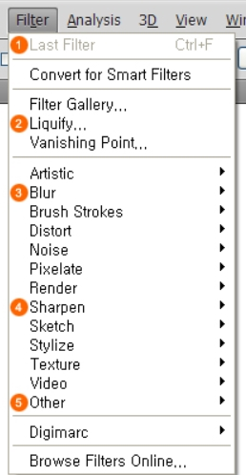
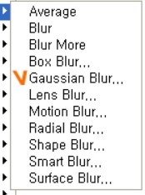
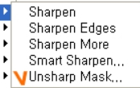
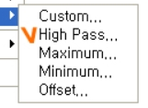
FILTER Understanding
Filter: Giving many effects in the image or text
Convert for smart filters:
Filter function that can be edited while maintaining its original
VANISH POINT:
The function which maintain
and copy perspective in accordance with the vanishing point
Filter Gallery:
You can apply a filter , and can use immediate preview function,
see filter application results.
BLUR EFFECT:
Vignétting
Artistic EFFECT:
Conversion into a picturesque image
SHARPEN EFFECT: Clearly

Slide 2
FILTER Understanding
Artistic : Conversion into a picturesque image
Brush Stroke : Brushstroke effect application on image
Distort : Various distortion of images
Noise : Rough expressions by adding noise to the image
Pixelate : Expression of pixels of images reconstructing
by crystal, cotton, halftone
Render : Flat images as stereoscopic images
Sharpen : Express the images clearly, roughly
Sketch : Creating a picturesque image
by emphasizing drawing or sketch effect
Stylize : Creating images as a new style
Texture : Adding many textures on images
Video : When you want to optimize image color on TV
Other : Transformation of colors as other filters
Digimarc : Use to specify the copyright information to images or
to read the copyright information

Slide 3
FILTER Understanding
Artistic filters
Filters from the Artistic submenu help you achieve painterly and artistic effects for a fine arts or commercial project. For example, use the Cutout filter for collages or typography. These filters replicate natural or traditional media effects. All the Artistic filters can be applied through the Filter Gallery.
Color pencil : Draws an image using colored pencils on a solid background. Edges are retained and given a rough crosshatch appearance; the solid background color shows through the smoother areas. Cutout :Makes an image appear as though it were constructed from roughly cut pieces of colored paper. High-contrast images appear as if in silhouette, and colored images are built up from several layers of colored paper. Dry brush : Paints the edges of the image using a dry brush technique (between oil and watercolor). The filter simplifies an image by reducing its range of colors to areas of common color. Film grain : Applies an even pattern to the shadow tones and midtones. A smoother, more saturated pattern is added to the lighter areas. This filter is useful for eliminating banding in blends and visually unifying elements from various sources Fresco : Paints an image in a coarse style using short, rounded, and hastily applied daubs. Neon glow : Adds various types of glows to the objects in an image. This filter is useful for colorizing an image while softening its look. To select a glow color, click the glow box, and select a color from the Color Picker. Paint daubs : Lets you choose from various brush sizes (from 1 to 50) and types for a painterly effect. Brush types include Simple, Light Rough, Dark Rough, Wide Sharp, Wide Blurry, and Sparkle. Palette knift :Reduces detail in an image to give the effect of a thinly painted canvas that reveals the texture underneath. Plastic wrap : Coats the image in shiny plastic, accentuating the surface detail. Poster edges : Reduces the number of colors in an image (posterizes it) according to the posterization option you set, and finds the edges of the image and draws black lines on them. Large broad areas have simple shading, and fine dark detail is distributed throughout the image.
Rough pastels : Applies strokes of pastel chalk on a textured background. In areas of bright color, the chalk appears thick with little texture; in darker areas, the chalk appears scraped off to reveal the texture. Smudge stick : Softens an image using short diagonal strokes to smudge or smear the darker areas. Lighter areas become brighter and lose detail. Sponge : Creates images with highly textured areas of contrasting color, simulating the effect of sponge painting. Underpaint : Paints the image on a textured background, and then paints the final image over it. Water color : Paints the image in a watercolor style using a medium brush loaded with water and color, simplifying details. Where significant tonal changes occur at the edges, the filter saturates the color.

Slide 4
FILTER Understanding
Blur filters The Blur filters soften a selection or an entire image, and are useful for retouching. They smooth transitions by averaging the pixels next to the hard edges of defined lines and shaded areas in an image.
Average : Finds the average color of an image or selection, and then fills the image or selection with the color to create a smooth look. For example, if you select an area of grass, the filter changes the area into a homogeneous patch of green.
Blur more : Eliminate noise where significant color transitions occur in an image. Blur filters smooth transitions by averaging the pixels next to the hard edges of defined lines and shaded areas. The effect of the Blur More filter is three or four times stronger than that of the Blur filter.
Gaussian blur : Quickly blurs a selection by an adjustable amount. Gaussian refers to the bell-shaped curve that is generated when Photoshop applies a weighted average to the pixels. The Gaussian Blur filter adds low-frequency detail and can produce a hazy effect.
Motion Blur : Blurs in the specified direction (from –360º to +360º) and at a specified intensity (from 1 to 999). The filter’s effect is analogous to taking a picture of a moving object with a fixed exposure time.
Radial blur : Simulates the blur of a zooming or rotating camera to produce a soft blur. Choose Spin to blur along concentric circular lines, and then specify a degree of rotation. Choose Zoom to blur along radial lines, as if zooming into or out of the image, and specify a value from 1 to 100. Blur quality ranges from Draft (for fast but grainy results)or Good and Best for smoother results, which are indistinguishable from each other except on a large selection. Specify the origin of the blur by dragging the pattern in the Blur Center box. Smart blur : Blurs an image with precision. You can specify a radius, a threshold, and a blur quality. The Radius value determines the size of the area searched for dissimilar pixels. The Threshold value determines how dissimilar the pixels must be before they are affected. You also can set a mode for the entire selection (Normal) or for the edges of color transitions (Edge Only and Overlay Edge). Where significant contrast occurs, Edge Only applies black-and-white edges, and Overlay Edge applies white.
Surface Blur :Blurs an image while preserving edges. This filter is useful for creating special effects and for removing noise or graininess. The Radius option specifies the size of the area sampled for the blur. The Threshold option controls how much the tonal values of neighboring pixels must diverge from the center pixel value before being part of the blur. Pixels with tonal value differences less than the Threshold value are excluded from the blur.
Shape Blur :Uses the specified kernel to create the blur. Choose a kernel from the list of custom shape presets, and use the radius slider to adjust its size. You can load different shape libraries by clicking the triangle and choosing from the list. Radius determines the size of the kernel; the larger the kernel, the greater the blur.
Lens Blur :Adds blur to an image to give the effect of a narrower depth of field so that some objects in the image stay in focus and others areas are blurred

Slide 5
FILTER Understanding
Brush stroke filters Like the Artistic filters, the Brush Stroke filters give a painterly or fine-arts look using different brush and ink stroke effects. Some of the filters add grain, paint, noise, edge detail, or texture. All the Brush Stroke filters can be applied through the Filter Gallery.
Accents edges : Accentuates the edges of an image. When the edge brightness control is set to a high value, the accents resemble white chalk; when set to a low value, the accents resemble black ink.
Angled strokes : Repaints an image using diagonal strokes, with lighter and darker areas painted in strokes going in opposite directions.
Crosshatch : Preserves the details and features of the original image while adding texture and roughening the edges of the colored areas with simulated pencil hatching. The Strength option (with values from 1 to 3) determines the number of hatching passes.
Dark strokes : Paints dark areas with short, tight, dark strokes, and lighter areas with long, white strokes.
Ink outlines : Redraws an image with fine narrow lines over the original details,
in pen-and-ink style.
Spatter : Replicates the effect of a spatter airbrush. Increasing the options simplifies the overall effect.
Sprayed strokes : Repaints an image, using its dominant colors, with angled, sprayed strokes of color.
Sumie : Paints an image in Japanese style, as if with a fully saturated brush applied to rice paper. Sumi‑e creates soft, blurred edges with rich, inky blacks.

Slide 6
FILTER Understanding
Distort filters
The Distort filters geometrically distort an image, creating 3D or other reshaping effects. Note that these filters can be very memory-intensive. The Diffuse Glow, Glass, and Ocean Ripple filters can be applied through the Filter Gallery.
Diffuse Glow
Renders an image as though it were viewed through a soft diffusion filter. The filter adds see-through white noise, with the glow fading from the center of a selection.
Displace
Uses an image, called a displacement map, to determine how to distort a selection. For example, using a parabola-shaped displacement map, you can create an image that appears to be printed on a cloth held up by its corners.
Glass
Makes an image appear as if it were being viewed through different types of glass. You can choose a glass effect or create your own glass surface as a Photoshop file and apply it. You can adjust scaling, distortion, and smoothness settings. When using surface controls with a file, follow the instructions for the Displace filter.
Ocean Ripple
Adds randomly spaced ripples to the surface of the image so that it appears to be underwater.
Pinch
Squeezes a selection. A positive value up to 100% shifts a selection toward its center; a negative value up to – 100% shifts a selection outward.
Polar Coordinates
Converts a selection from its rectangular to polar coordinates, and vice versa, according to a selected option. You can use this filter to create a cylinder anamorphosis—an art form popular in the 18th century—in which the distorted image appears normal when viewed in a mirrored cylinder.

Slide 7
FILTER Understanding
Distort filters
Ripple
Creates an undulating pattern on a selection, like ripples on the surface of a pond. For greater control, use the Wave filter. Options include the number and size of ripples.
Shear
Distorts an image along a curve. Specify the curve by dragging the line in the box. You can adjust any point along the curve. Click Default to change the curve back to a straight line. In addition, you choose how to treat undistorted areas.
Spherize
Gives objects a 3D effect by wrapping a selection around a spherical shape, distorting the image and stretching it to fit the selected curve.
Twirl
Rotates a selection more sharply in the center than at the edges. Specifying an angle produces a twirl
pattern.
Wave
Works much as the Ripple filter does, but with greater control. Options include the number of wave
generators, wavelength (distance from one wave crest to the next), height of the wave, and
wave type: Sine (rolling), Triangle, or Square. The Randomize option applies random values.
You can also define undistorted areas.
ZigZag
Distorts a selection radially, depending on the radius of the pixels in your selection.
The Ridges option sets the number of direction reversals of the zigzag from the center of the selection
to its edge.
You also specify how to displace the pixels: Pond Ripples displaces pixels to the upper-left or lower right, Out From Center displaces pixels toward or away from the center of the selection, and Around Center rotates pixels around the center

Slide 8
FILTER Understanding
Noise filters
The Noise filters add or remove noise, or pixels with randomly distributed color levels. This helps to blend a selection into the surrounding pixels. Noise filters can create unusual textures or remove problem areas, such as dust and scratches.
Add Noise
Applies random pixels to an image, simulating the effect of shooting pictures on high-speed film.
You can also use the Add Noise filter to reduce banding in feathered selections or graduated fills or to give a more realistic look to heavily retouched areas. Options for noise distribution include Uniform and Gaussian. Uniform distributes color values of noise using random numbers between 0 and plus or minus the specified value, creating a subtle effect. Gaussian distributes color values of noise along a bell-shaped curve, creating a speckled effect. The Monochromatic option applies the filter to only the tonal elements in the image without changing the colors.
Despeckle
Detects the edges in an image (areas where significant color changes occur) and blurs all of the
selection except those edges. This blurring removes noise while preserving detail.
Dust & Scratches
Reduces noise by changing dissimilar pixels. To achieve a balance between sharpening the image and hiding defects,
try various combinations of Radius and Threshold settings. Or apply the filter to selected areas in the image.
Median
Reduces noise in an image by blending the brightness of pixels within a selection. The filter searches the radius of a pixel selection for pixels of similar brightness, discarding pixels that differ too much from adjacent pixels, and replaces the center pixel with the median brightness value of the searched pixels. This filter is useful for eliminating or reducing the effect of motion on an image.
Reduce Noise
Reduces noise while preserving edges based on user settings affecting the overall image or individual channels

Slide 9
FILTER Understanding
Pixelate filters
The filters in the Pixelate submenu sharply define a selection by clumping pixels of similar color values in cells.
Color Halftone
Simulates the effect of using an enlarged halftone screen on each channel of the image. For each channel, the filter divides the image into rectangles and replaces each rectangle with a circle. The circle size is proportional to the brightness of the rectangle.
Crystallize
Clumps pixels into a solid color in a polygon shape.
Facet
Clumps pixels of solid or similar colors into blocks of like-colored pixels. You can use this filter to make a scanned image look hand-painted or to make a realistic image resemble an abstract painting.
Fragment
Creates four copies of the pixels in the selection, averages them, and offsets them from each other.
Mezzotint
Converts an image to a random pattern of black-and-white areas or of fully saturated colors in a color image. To use the filter,
choose a dot pattern from the Type menu in the Mezzotint dialog box.
Mosaic
Clumps pixels into square blocks. The pixels in a given block are the same color, and the colors of the blocks represent the colors in the selection
.
Pointillize
Breaks up the color in an image into randomly placed dots, as in a pointillist painting, and uses the background color as a canvas area between the dots.

Slide 10
FILTER Understanding
Render filters
The Render filters create 3D shapes, cloud patterns, refraction patterns, and simulated light reflections in an image. You can also manipulate objects in 3D space, create 3D objects (cubes, spheres, and cylinders), and create texture fills from grayscale files to produce 3D-like effects for lighting.
Clouds
Generates a soft cloud pattern using random values that vary between the foreground and the background colors. To generate a more stark cloud pattern, hold down Alt (Windows) or Option (Mac OS) as you choose Filter > Render > Clouds. When you apply the Clouds filter, the image data on the active layer is replaced.
Difference Clouds
Uses randomly generated values that vary between the foreground and background color to produce a cloud pattern. The filter blends the cloud data with the existing pixels in the same way the Difference mode blends colors. The first time you choose this filter, portions of the image are inverted in a cloud pattern. Applying the filter several times creates rib and vein patterns that resemble a marble texture. When you apply the Difference Clouds filter, the image data on the active layer is replaced.
Fibers
Creates the look of woven fibers using the foreground and background colors. You use the Variance slider to control how the colors vary (a low value produces long streaks of color, and a high value results in very short fibers with more varied distribution of color). The Strength slider controls how each fiber looks. A low setting produces a loose weave, and a high setting produces short, stringy fibers. Click the Randomize button to change how the pattern looks; you can click the button a number of times until you find a pattern you like. When you apply the Fibers filter, the image data on the active layer is replaced.
Lens Flare
Simulates the refraction caused by shining a bright light into a camera lens. Specify a location for the center of the flare by clicking anywhere inside the image thumbnail or by dragging its cross hair.
Lighting Effects
Lets you produce myriad lighting effects on RGB images by varying 17 light styles, three light types, and four sets of light properties. You can also use textures from grayscale files (called bump maps) to produce 3D-like effects and save your own styles for use in other images.

Slide 11
FILTER Understanding
Sharpen filters
The Sharpen filters focus blurred images by increasing the contrast of adjacent pixels.
Sharpen and Sharpen More
Focus a selection and improve its clarity. The Sharpen More filter applies a stronger sharpening effect than does the Sharpen filter.
Sharpen Edges and Unsharp Mask
Find the areas in the image where significant color changes occur and sharpen them. The Sharpen Edges filter sharpens only edges while preserving the overall smoothness of the image. Use this filter to sharpen edges without specifying an amount. For professional color correction, use the Unsharp Mask filter to adjust the contrast of edge detail and produce a lighter and darker line on each side of the edge. This process emphasizes the edge and creates the illusion of a sharper image.
Smart Sharpen
Sharpens an image by letting you set the sharpening algorithm or control the amount of sharpening that occurs in shadows and highlights. This is the recommended way to sharpen if you don’t have a particular sharpening filter in mind.
In Photoshop CC, the enhanced Smart Sharpen filter empowers you to produce high-quality results through adaptive sharpening technology that minimizes noise and halo effects. The streamlined UI design for this filter offers optimized controls for targeted sharpening. Use the sliders for quick adjustments and advanced controls to fine-tune your results.
Smart sharpening in Photoshop CC supports CMYK. Additionally, you can sharpen arbitrary channels. For example, you can choose to sharpen just the blue channel, green channel, or the alpha channel

Slide 12
FILTER Understanding
Sketch filters
Filters in the Sketch submenu add texture to images, often for a 3D effect. The filters also are useful for creating a fine-arts or hand-drawn look. Many of the Sketch filters use the foreground and background color as they redraw the image. All the Sketch filters can be applied through the Filter Gallery.
Bas Relief
Transforms an image so that it appears carved in low relief and lit to accent the surface variations. Dark areas of the image take on the foreground color, and light colors use the background color.
Chalk & Charcoal
Redraws highlights and midtones with a solid midtone gray background drawn in coarse chalk. Shadow areas are replaced with black diagonal charcoal lines. The charcoal is drawn in the foreground color; the chalk, in the background color.
Charcoal
Creates a posterized, smudged effect. Major edges are boldly drawn, and midtones are sketched using a diagonal stroke. Charcoal is the foreground color, and the background is the color of the paper.
Chrome
Renders the image as if it had a polished chrome surface. Highlights are high points, and shadows are low points in the reflecting surface. After applying the filter, use the Levels dialog box to add more contrast to the image.
Conté Crayon
Replicates the texture of dense dark and pure white Conté crayons on an image. The Conté Crayon filter uses the foreground color for dark areas and the background color for light areas. For a truer effect, change the foreground color to one of the common Conté Crayon colors (black, sepia, or sanguine) before applying the filter. For a muted effect, change the background color to white, add some of the foreground color to the white background, and then apply the filter.
Halftone Pattern
Simulates the effect of a halftone screen while maintaining the continuous range of tones.
Water Paper
Uses blotchy daubs that appear painted onto fibrous, damp paper, causing the colors to flow and blend.

Slide 13
FILTER Understanding
Sketch filters
Graphic Pen
Uses fine, linear ink strokes to capture the details in the original image. The effect is especially striking with scanned images. The filter replaces color in the original image, using the foreground color for ink and the background color for paper.
d onto fibrous, damp paper, causing the colors to flow and blend.
Note Paper
Creates an image that appears to be constructed of handmade paper. This filter simplifies images and combines the effects of the Stylize > Emboss and Texture > Grain filters. Dark areas of the image appear as holes in the top layer of paper, revealing the background color.
Photocopy
Simulates the effect of photocopying an image. Large dark areas tend to be copied only around their edges, and midtones fall away to either solid black or solid white.
Plaster
Molds an image from 3D plaster, and then colorizes the result using the foreground and background color. Dark areas are raised, and light areas are recessed.
Reticulation
Simulates the controlled shrinking and distortion of film emulsion to create an image that appears clumped in the shadows and lightly grained in the highlights.
Stamp
Simplifies the image so that it appears to be created with a rubber or wood stamp. This filter is best used with black-and-white images.
Torn Edges
Reconstructs the image so that it appears composed of ragged, torn pieces of paper, and then colorizes the image using the foreground and background colors. This filter is particularly useful for text or high-contrast objects.

Slide 14
FILTER Understanding
Stylize filters
The Stylize filters produce a painted or impressionistic effect on a selection by displacing pixels and by finding and heightening contrast in an image. After using filters like Find Edges and Trace Contour that highlight edges, you can apply the Invert command to outline the edges of a color image with colored lines or to outline the edges of a grayscale image with white lines.
Diffuse
Shuffles pixels in a selection to soften focus according to the selected option: Normal moves pixels randomly (ignoring color values), Darken Only replaces light pixels with darker ones, and Lighten Only replaces dark pixels with lighter ones. Anisotropic shuffles pixels in the direction of the least change in color.
Emboss
Makes a selection appear raised or stamped by converting its fill color to gray and tracing the edges with the original fill color. Options include an embossing angle (from –360° to recess the surface, to +360° to raise the surface), height, and a percentage (1% to 500%) for the amount of color within the selection. To retain color and detail when embossing, use the Fade command after applying the Emboss filter.
Extrude
Gives a 3D texture to a selection or layer. .
Find Edges
Identifies the areas of the image with significant transitions and emphasizes the edges. Like the Trace Counter filter, Find Edges outlines the edges of an image with dark lines against a white background and is useful for creating a border around an image.
Glowing Edges
Identifies the edges of color and adds a neon-like glow to them. This filter can be applied cumulatively.
Solarize
Blends a negative and a positive image—similar to exposing a photographic print briefly to light during development.
Tiles
Breaks up an image into a series of tiles, creating an offset between the selection and its original position. You can choose one of the following to fill the area between the tiles: the background color, the foreground color, a reverse version of the image, or an unaltered version of the image, which puts the tiled version on top of the original and reveals part of the original image underneath the tiled edges.
Trace Contour
Finds the transitions of major brightness areas and thinly outlines them for each color channel, for an effect similar to the lines in a contour map.
Wind
Places tiny horizontal lines in the image to create a windblown effect. Methods include Wind; Blast, for a more dramatic wind effect; and Stagger, which offsets the lines in the image

Slide 15
FILTER Understanding
Texture filters
Use the Texture filters to simulate the appearance of depth or substance, or to add an organic look.
Craquelure
Paints an image onto a high-relief plaster surface, producing a fine network of cracks that follow the contours of the image. Use this filter to create an embossing effect with images that contain a broad range of color or grayscale values.
Grain
Adds texture to an image by simulating different kinds of grain—Regular, Soft, Sprinkles, Clumped, Contrasty, Enlarged, Stippled, Horizontal, Vertical, and Speckle, available from the Grain Type menu.
Mosaic Tiles
Renders the image so that it appears to be made up of small chips or tiles and adds grout between the tiles. (In contrast, the Pixelate>Mosaic filter breaks up an image into blocks of different-colored pixels.)
Patchwork
Breaks up an image into squares filled with the predominant color in that area of the image. The filter randomly reduces or increases the tile depth to replicate the highlights and shadows.
Stained Glass
Repaints an image as single-colored adjacent cells outlined in the foreground color.
Texturizer
Applies a texture you select or create to an image.
Video filters
The Video submenu contains the De-Interlace and NTSC Colors filters.
De-Interlace
Smooths moving images captured on video by removing either the odd or even interlaced lines in a video image. You can choose to replace the discarded lines by duplication or interpolation.
NTSC Colors
Restricts the gamut of colors to those acceptable for television reproduction, to prevent oversaturated colors from bleeding across television scan lines.

Slide 16
FILTER Understanding
Other filters
Filters in the Other submenu let you create your own filters, use filters to modify masks, offset a selection within an image, and make quick color adjustments.
Custom
Lets you design your own filter effect. With the Custom filter, you can change the brightness values of each pixel in the image according to a predefined mathematical operation known as convolution. Each pixel is reassigned a value based on the values of surrounding pixels. This operation is similar to the Add and Subtract calculations for channels.
You can save the custom filters you create and use them with other Photoshop images..
High Pass
Retains edge details in the specified radius where sharp color transitions occur and suppresses the rest of the image. (A radius of 0.1 pixel keeps only edge pixels.) The filter removes low-frequency detail from an image and has an effect opposite to that of the Gaussian Blur filter.
It is helpful to apply the High Pass filter to a continuous-tone image before using the Threshold command or converting the image to Bitmap mode. The filter is useful for extracting line art and large black-and-white areas from scanned images.
Maximum and Minimum
The Maximum and Minimum filters are useful for modifying masks. The Maximum filter has the effect of applying a spread (dilation)—spreading out white areas and choking in black areas. The Minimum filter has the effect of applying a choke (erosion)—shrinking white areas and spreading out the black areas. Like the Median filter, the Maximum and Minimum filters operate on selected pixels. Within a specified radius, the Maximum and Minimum filters replace the current pixel’s brightness value with the highest or lowest brightness value of the surrounding pixels.
These filters, especially with larger radii, tend to promote either corners or curves in the image contours. In Photoshop CC, you can choose from the Preserve menu to favor squareness or roundness as you specify the radius value
Offset
Moves a selection a specified horizontal or vertical amount, leaving an empty space at the selection’s original location. You can fill the empty area with the current background color, with another part of the image, or with your choice of fill if the selection is near the edge of an image.
Digimarc filters
The Digimarc filters embed a digital watermark into an image to store copyright information.
Note:
Digimarc plug-ins require a 32-bit operating system. They are unsupported in 64-bit versions of Windows and Mac OS.

Slide 17
Image production using the filter function and control layers
Convert from Smart filter:
One of the most important concepts to keep in mind when working with Photoshop's filters is Smart Filters. When you apply a filter to a pixel layer, that's it — the pixels are changed. But, when you apply a filter to a Smart Object, you create a Smart Filter.
With Smart Filters, you can apply one or more filters to a Smart Object and later change your mind about what settings — or even what filters — to use, without reverting to a saved copy of the file or using the History panel. Unlike adjustment layers, which are, in fact, separate layers in the image, Smart Filters work more like layer styles.
They appear in the Layers panel below the layer to which they're applied and can be shown or hidden by clicking an eyeball icon. (See this figure.) And, like layer styles, you can reopen a Smart Filter by double-clicking it in the Layers panel
As you can see in the figure, the layer Inside Passage-02 (the active layer, highlighted in the Layers panel) has both layer effects and Smart Filters applied. The type layer above has only layer effects, whereas the other two Smart Objects, below in the Layers panel, have Smart Filters but no layer effects.
Clicking the triangle to the far right of a layer name expands and collapses the list of effects and filters applied. Clicking the eyeball icon to the left of an item hides it without removing it.
You can delete a Smart Filter by dragging it to the Trash icon (just as you can with layer effects), which removes its effect from the Smart Object. To reopen a filter's dialog box to change settings, simply double-click the filter name in the layers panel.
Smart Filters can be applied only to Smart Objects. Luckily, you can convert any pixel-based layer,even a background layer, to a Smart Object simply by selecting that layer in the Layers panel and choosing Layer→ Smart Objects→ Convert to Smart Object. You can even select multiple layers in the layers panel and create a single Smart Object with that command.
You can then apply a Smart Filter to all of the layers in the Smart Object. If you later need to alter the content of the Smart Object itself, double-click it in the Layers panel. The Smart Object’s contents opens in a separate image window. After making the necessary changes, use the Save command (not Save As) and then close the window. The Smart Object will be updated in your artwork and any Smart Filters will be reapplied.
Because you can easily remove or change Smart Filters, they provide you with a special sort of creative license: the
license to experiment and change your mind.
Because they are nondestructive (they don't make permanent changes to the pixels in your image), you can use Smart
Filters without fear of damaging your image. Of course that doesn't mean you shouldn't work on a copy of your beautiful
photo — it's always better to safeguard the original image file and work on a duplicate.

Slide 18
Image production using the filter function and control layers
Vanishing Point
The Vanishing Point feature preserves correct perspective in edits of images that contain perspective planes (for instance, the sides of a building or any rectangular object).
Adjustment layer
An adjustment layer applies color and tonal adjustments to your image without permanently changing pixel values. For example, rather than making a Levels or Curves adjustment directly to your image, you can create a Levels or Curves adjustment layer. The color and tonal adjustments are stored in the adjustment layer and apply to all the layers below it; you can correct multiple layers by making a single adjustment, rather than adjusting each layer separately. You can discard your changes and restore the original image at any time.

Slide 19
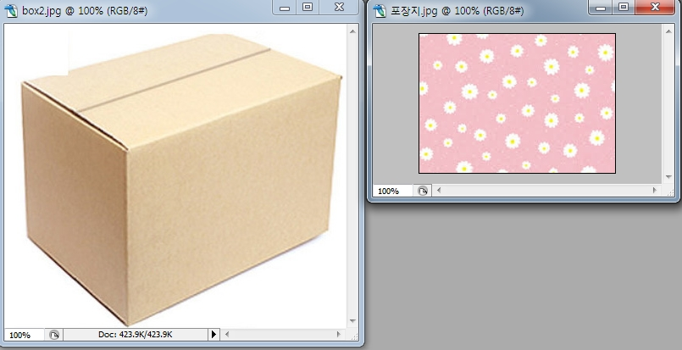
Image production using the filter function and control layers
1. If you want to put your image or text, package image on the
outside of box surface,
FILE> Box open, or Text image, package image open
2. First, if you want to put the package image on the outside of
box surface>Click the package image> Ctrl +A, only Ctrl +C>
Not to do Ctrl +V

Slide 20
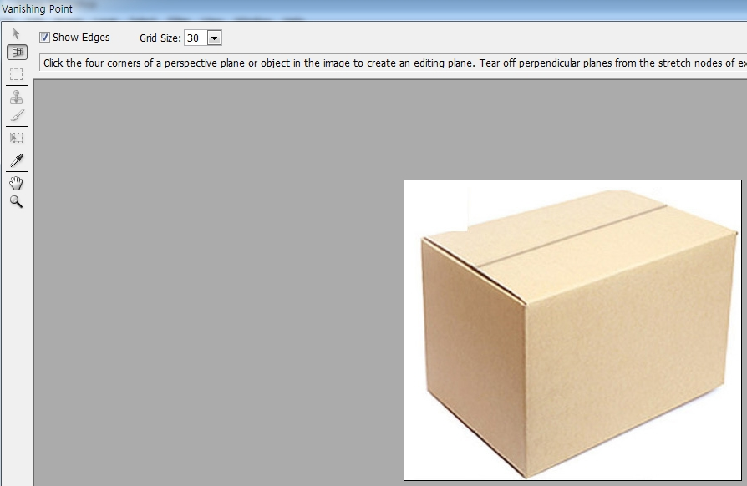
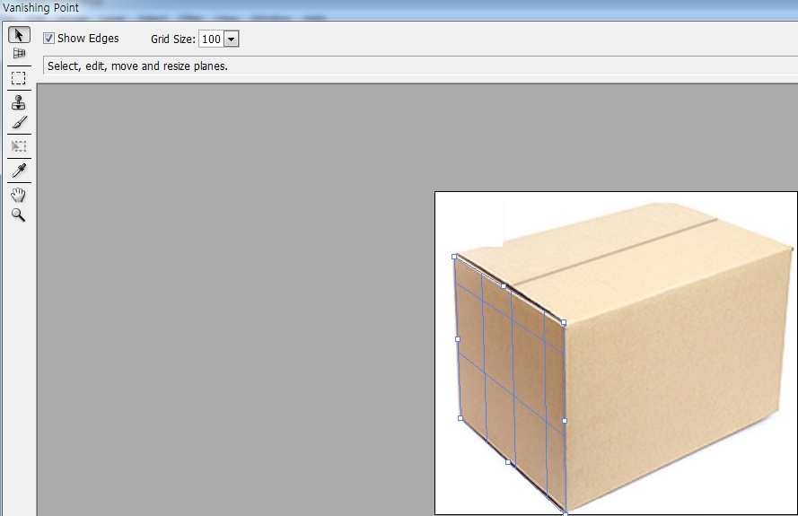
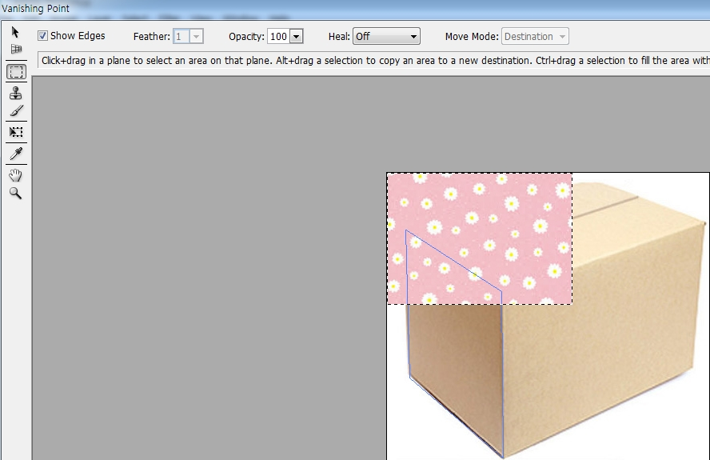
Image production using the filter function and control layers
3. Click box image>box layer> Filter> Vanish Point
Create Plane Tool
Marquee Tool
Transform Tool
4. Making the area to insert the package image by Create Plane Tool> Ctrl +V

Slide 21
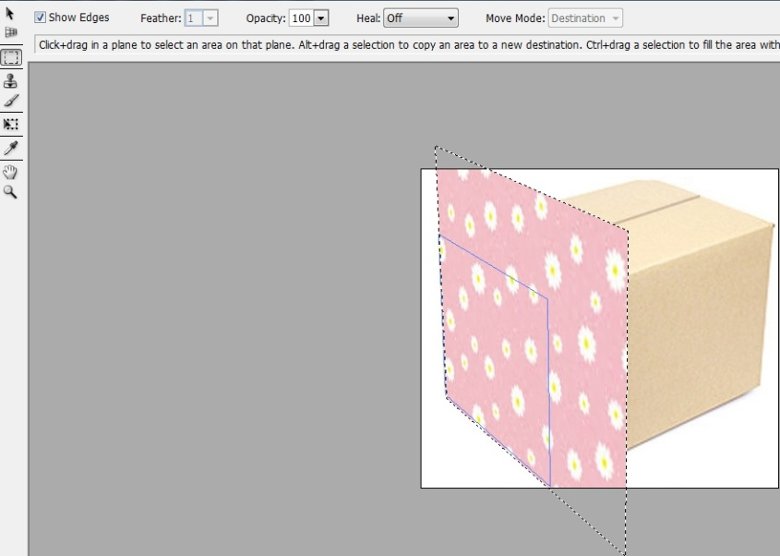
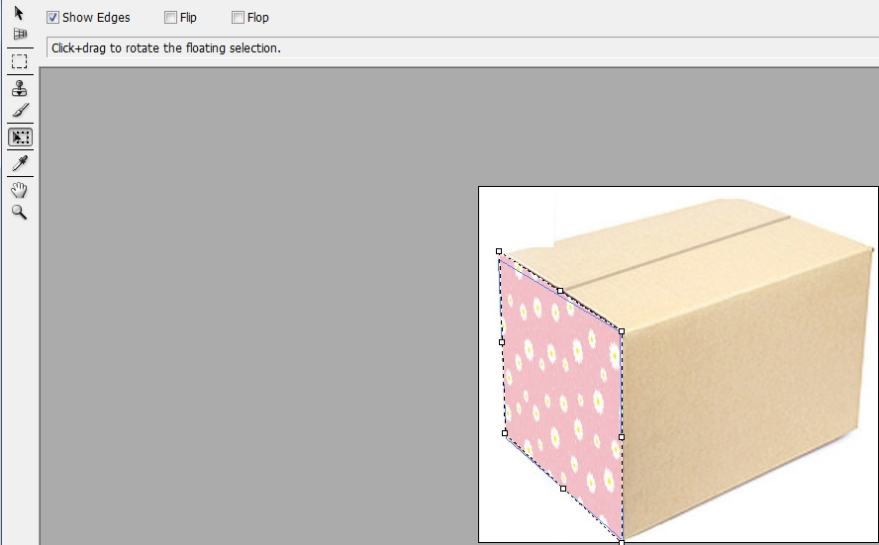
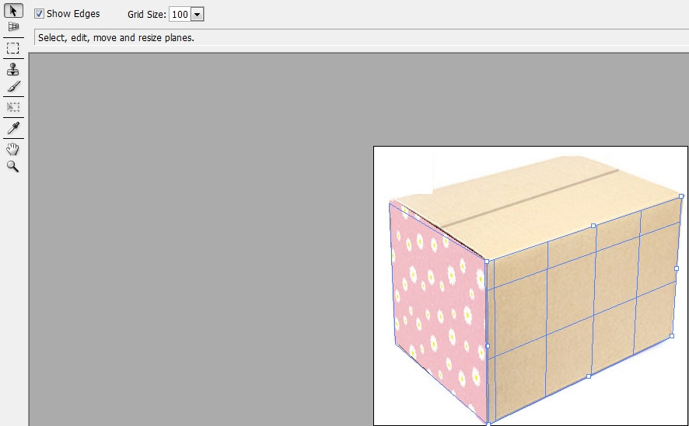
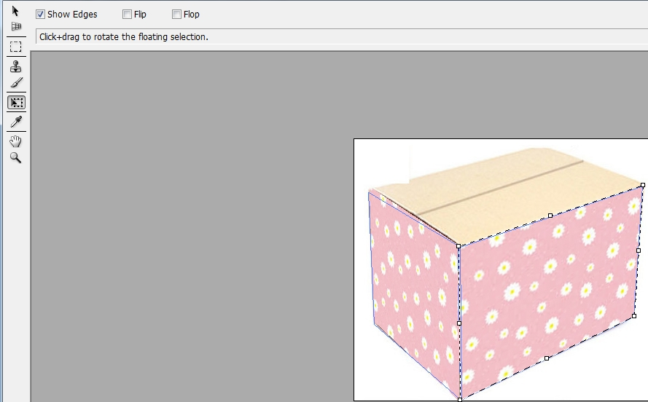
Image production using the filter function and control layers
5. Possible to tilt the area to insert the package image>Click Marquee Tool > Drag into the area to put the package
6. Adjust the size, the location by Transform Tool>Ctrl+V
7. Click Marquee Tool > Drag into the other area to put the package>Adjust the size, the location by Transform Tool>Ctrl+V,

Slide 22
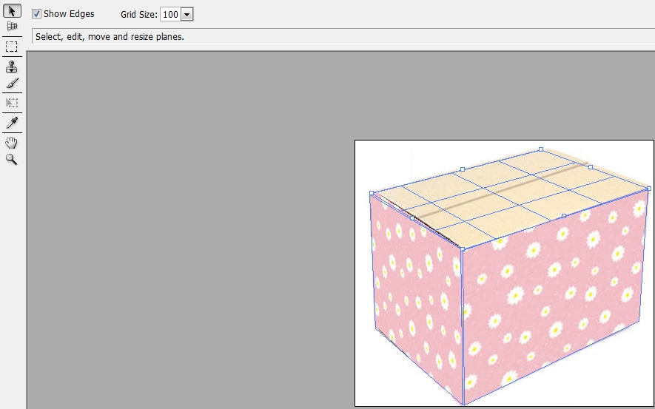
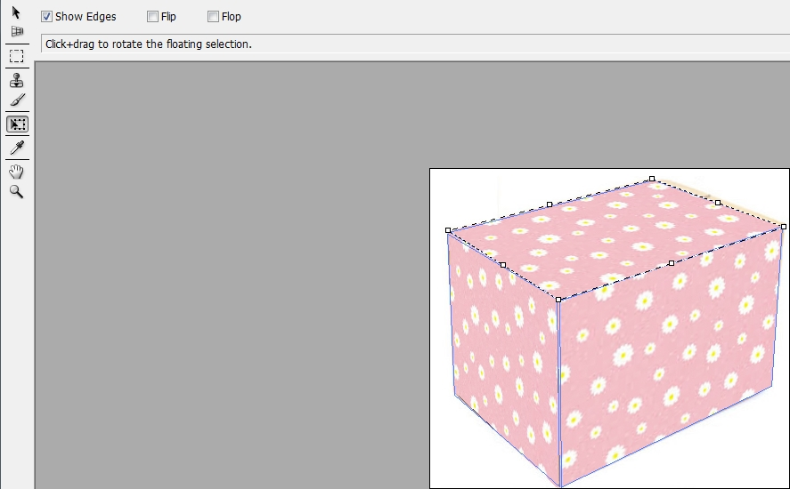
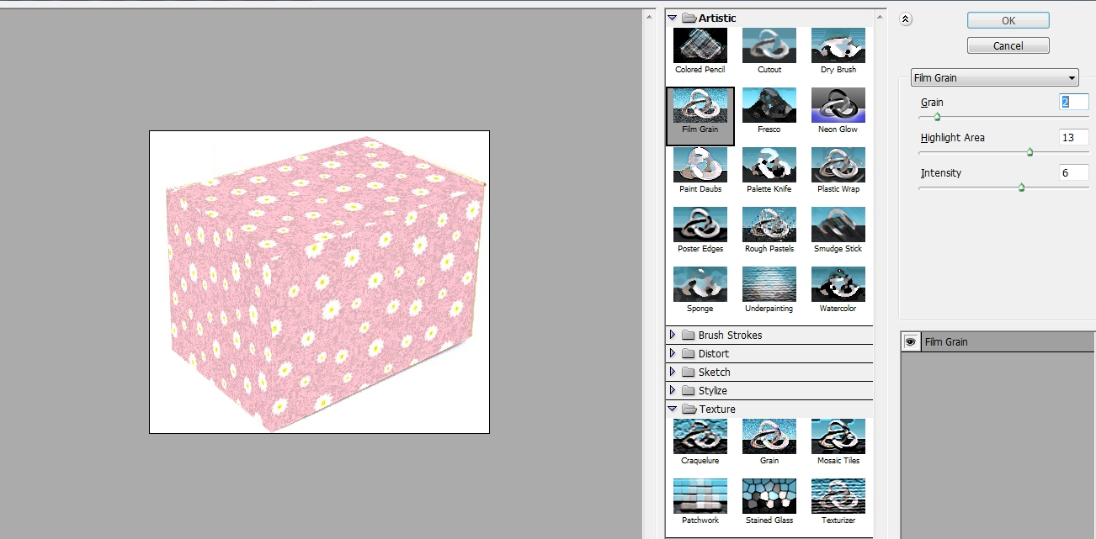
Image production using the filter function and control layers
8. Do one more time >Click Marquee Tool > Drag into the other area to put the package>Adjust the size, the location by Transform Tool>Ctrl+V>OK
9. Filter> filter gallery> Artistic> Film grain> Adjust Grain, Highlight, intensity>OK

Slide 23
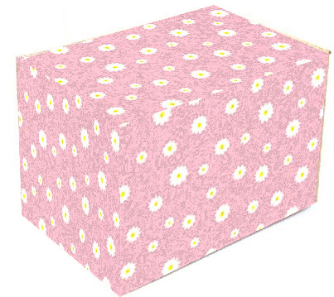
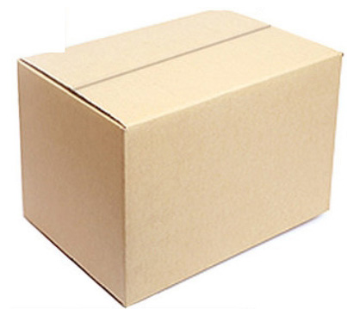
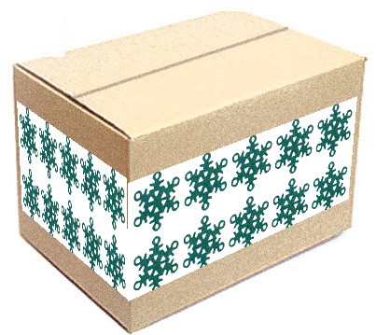
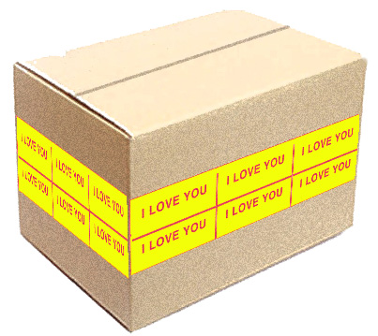
Image production using the filter function and control layers

Slide 24
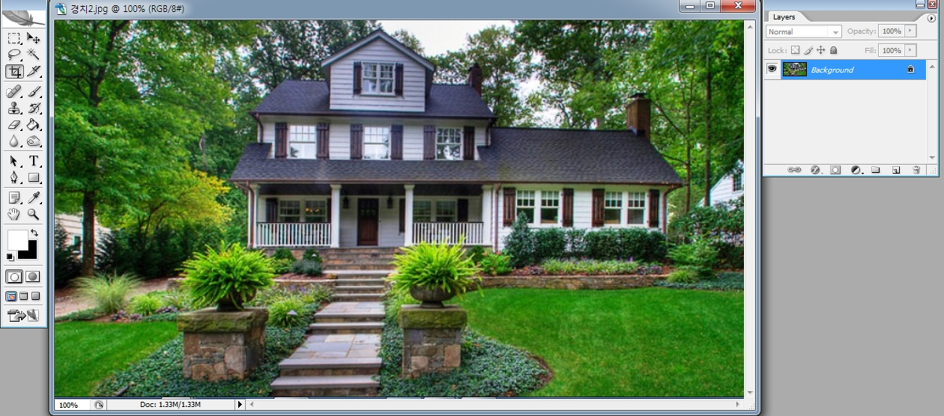
Making Misty house using filters
FILE> One Beautiful photo Open
Foreground color: White. Background color: Black
Choose background layer of beautiful photo> Add layer

Slide 25
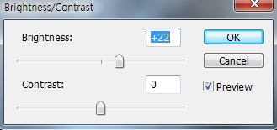
Making Misty house using filters
4. In the added layer>Filter>Render>Cloud
5. In layer1 gave filter effect> Image> Adjustment> Contrast/Brightness >
Brightness to the right ,to the right side

Slide 26
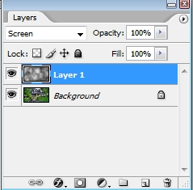
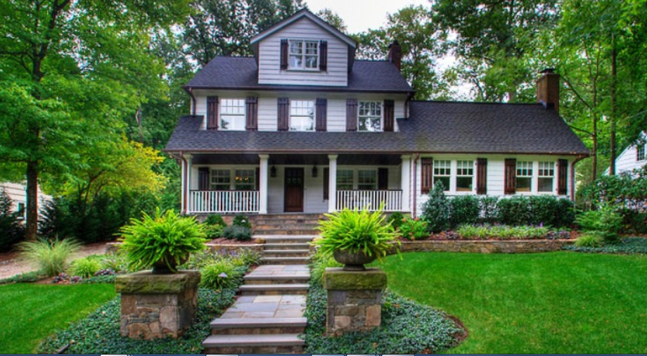
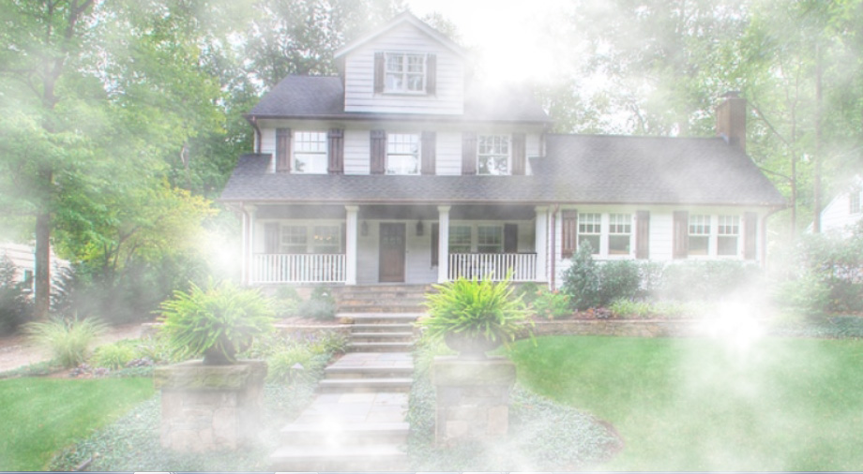
Making Misty house using filters
6. Mode: Change the mode from normal to screen

Slide 27
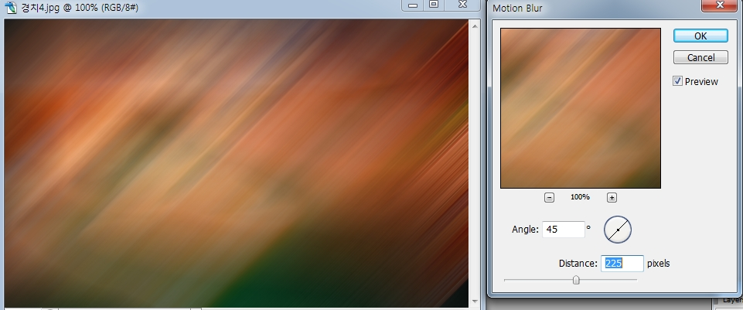
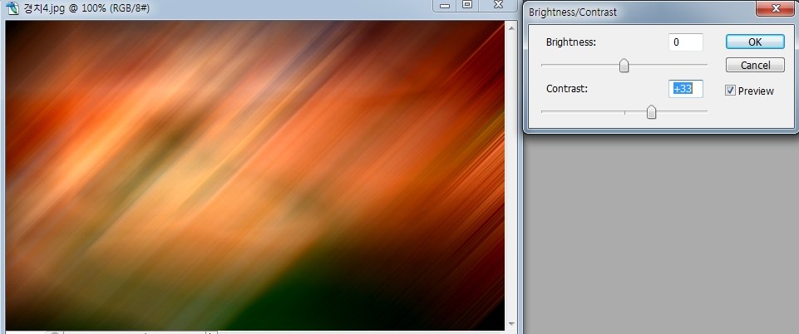
Cybertic space image using filters
FILE> Open Landscape photo or night photo
Filter> Blur> Motion blur Angle:45 Distance: 225 To high levels
3. Image> Adjustment> Contrast/Brightness Contrast: highly

Slide 28
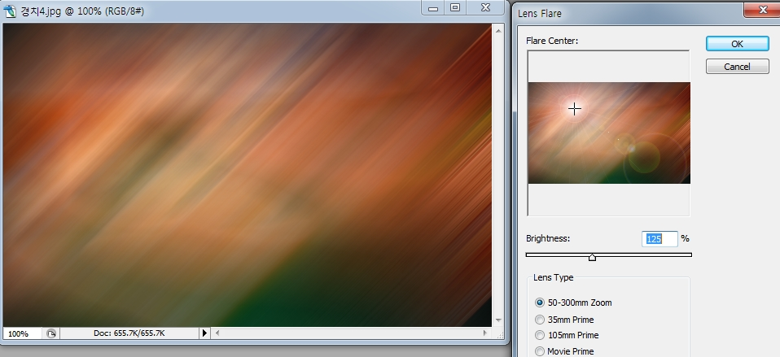
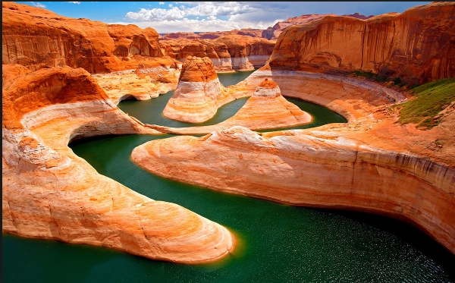
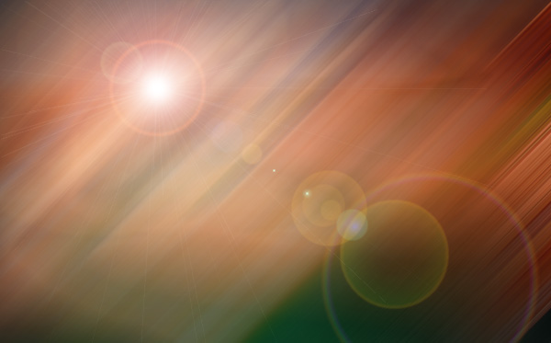
Cybertic space image using filters
4. Filter> Render > Rens Flare>Press the light area>Brightness: 125 , Lens type:50-30 zoom

Slide 29
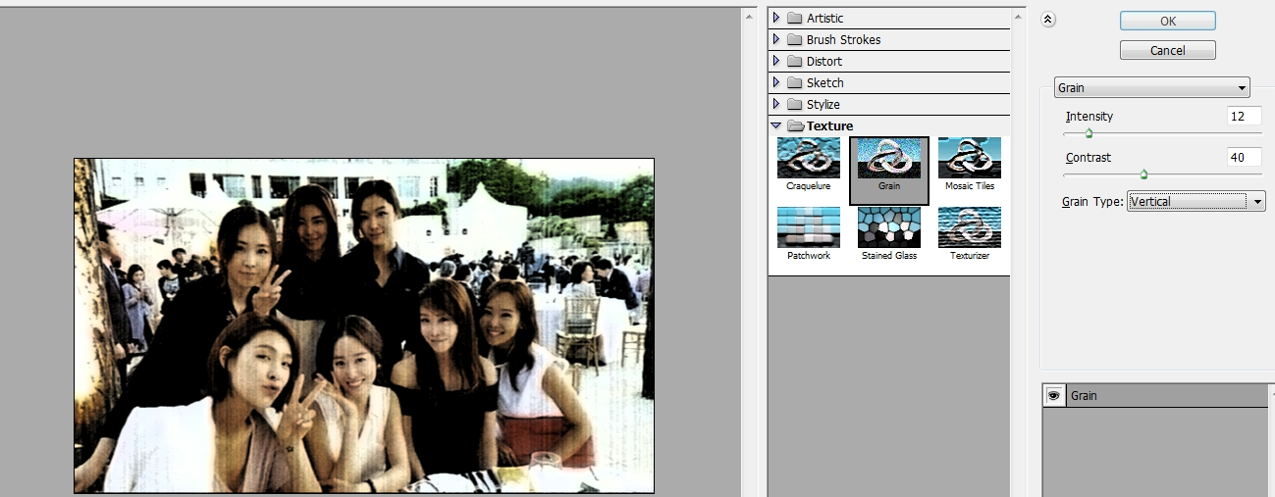
Making old photos using filters
FILE> Open photo
Filter>Texture>Grain
Grain type: vertical, Intensity:12, Contrast:40 > OK

Slide 30
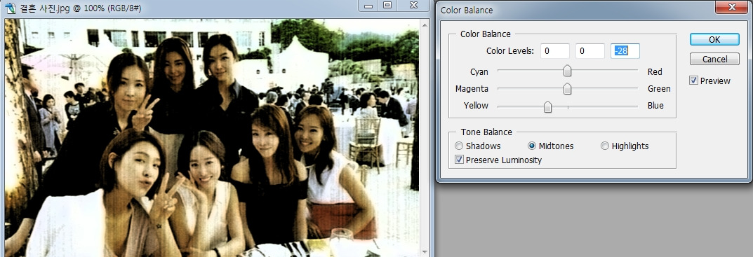
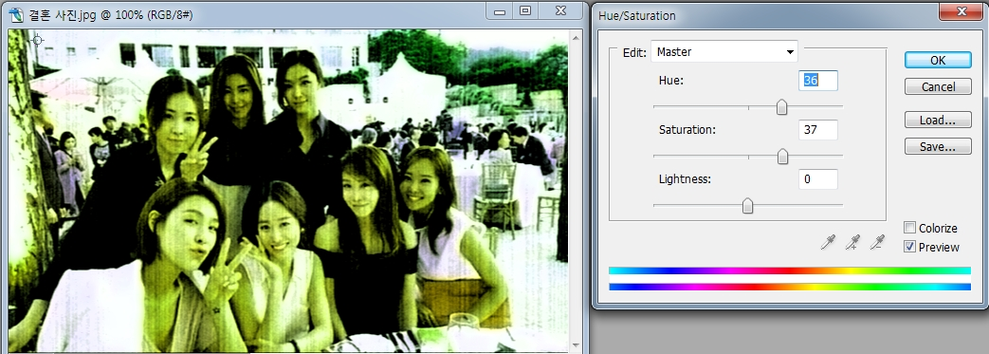
Making old photos using filters
In layer1 gave filter effect> Image> Adjustment> Color Balance> To the Yellow side>OK
4. Image> Adjustment> Hue/Saturation Hue:36 Saturation :37

Slide 31
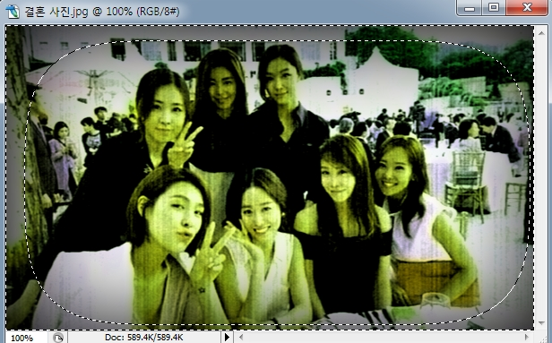
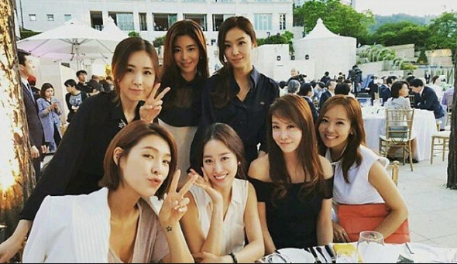
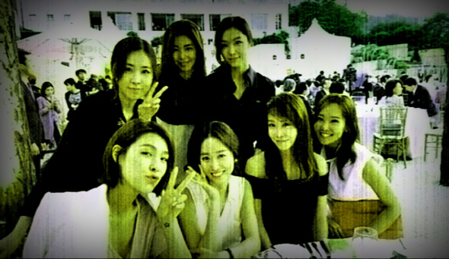
Making old photos using filters
5. Image> Adjustment> Auto Contrast
6. feather:50px, Make the rectangle by rectanglar marquee tool>Inverse>delete>Ctrl+D

