Slide 1
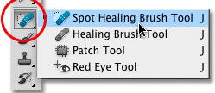
How to use the Healing Brush Tool
1. Select the Healing Brush tool in the Tools panel
(it’s a hidden tool of the Spot Healing Brush tool).
2. Find an area in the image that looks good and then Alt-click
(Windows) or Option-click (Mac) to sample that area.
For example, if you want to eliminate wrinkles on a face, choose a wrinkle-free area
of skin near the wrinkle. (Try to choose an area relatively close in skin tone.)
3. Position the mouse cursor over the area to be repaired and start painting.
The Healing Brush tool goes into action, blending and softening to create a realistic
repair of the area.
4. Repeat Steps 2 and 3 as necessary to repair the blemish, wrinkles, or scratches.

Slide 2
How to use the Spot Healing Brush Tool
1. Select the Spot Healing Brush tool from the toolbox. If necessary, click either the Healing Brush tool, Patch tool, or Red Eye tool to show the hidden tools and make your selection.
2. Choose a brush size in the options bar. A brush that is slightly larger than the area you want
to fix works best so that you can cover the entire area with one click.
3. (Optional) Choose a blending mode from the Mode menu in the options bar.
Choose Replace to preserve noise, film grain, and texture at the edges of the brush stroke
when using a soft‑edge brush.
4. Choose a Type option in the options bar:
Proximity Match :Uses pixels around the edge of the selection to find an area to use as a
patch.
Create Texture :Uses pixels in the selection to create a texture. If the texture doesn’t
work, try dragging through the area a second time.
Content-Aware :Compares nearby image content to seamlessly fill the selection,
realistically maintaining key details such as shadows and object edges.
5. Select Sample All Layers in the options bar to sample data from all visible layers. Deselect
Sample All Layers to sample only from the active layer.
6. Click the area you want to fix, or click and drag to smooth over imperfections in a larger
area.

Slide 3
How to use the patch Tool
1.Select the Patch tool .
2.Do one of the following:
Drag in the image to select the area you want to repair, and select Source in the options bar.
Drag in the image to select the area from which you want to sample, and select Destination in the
options bar. Note: You can also make a selection prior to selecting the Patch tool.
3. To adjust the selection, do one of the following:
Shift-drag in the image to add to the existing selection.
Alt-drag (Windows) or Option-drag (Mac OS) in the image to subtract from the existing selection.
Alt+Shift-drag (Windows) or Option+Shift-drag (Mac OS) in the image to select an area intersected
by the existing selection.
4. To extract texture with a transparent background from the sampled area, select Transparent.
Deselect this option if you want to fully replace the target area with the sampled area.
The Transparent option works best for solid or gradient backgrounds with clearly distinct textures
(such as a bird in a blue sky).
5. To control how quickly the pasted region adapts to the surrounding image, adjust the Diffusion slider.
Select a lower value for images with grain or fine details, or a higher value for smooth images.
6. Position the pointer inside the selection, and do one of the following:
If Source is selected in the options bar, drag the selection border to the area from which you want to
sample. When you release the mouse button, the originally selected area is patched with the sampled
pixels. If Destination is selected in the options bar, drag the selection border to the area you want to
patch. When you release the mouse button, the newly selected area is patched with the sampled
pixels.

Slide 4
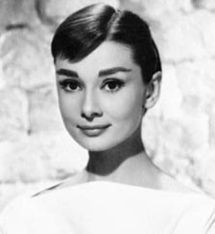
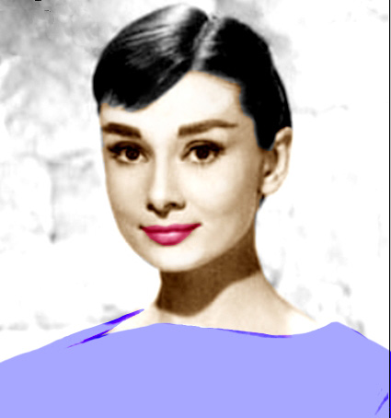
Black and white pictures into color pictures

Slide 5
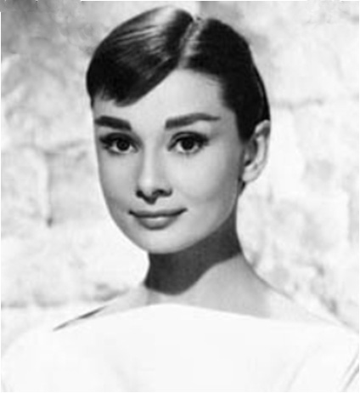
Black and white pictures to color pictures
File>Open> One Black and white picture
Remove blemishes and other imperfections by using Patch Tool, Spot Healing brush tool
Correct the picture screen in 100%

Slide 6
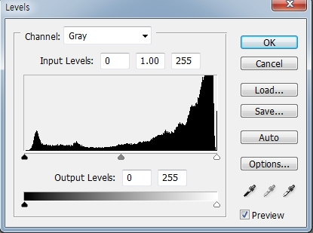
Black and white pictures to color pictures
For making the background white>Image>adjustment>level
Make the picture dark
Make the picture white
Order of the coloring
Face> Cloth> Background

Slide 7
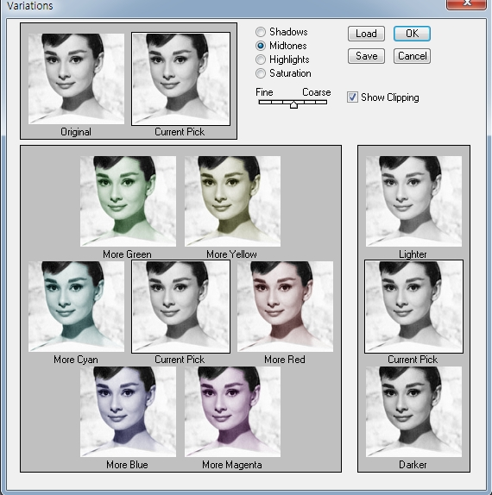
Black and white pictures to color pictures
In the standard mode, select the face area by the lasso tool>
Go to the Quick mask mode> Double-click Quick mask mode>
Quick mask option> Click Selected Areas OPACITY:50%>OK>
Color the face by proper brush tool>Go to standard mode
Image>Adjustment> Variations>Choose Original > Midtone> more red ,
more yellow클릭>OK> Ctrl+D

Slide 8
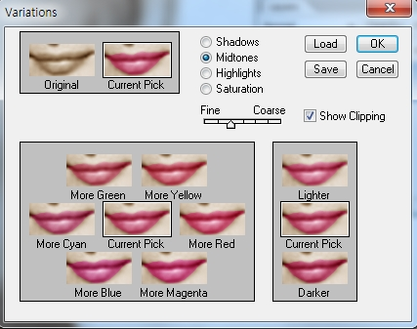
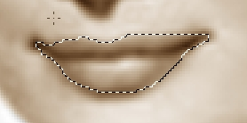
Black and white pictures to color pictures
In the standard mode, select the LIP area by the lasso tool>
Go to the Quick mask mode> Color the LIP by proper brush tool>Go to standard mode
Image>Adjustment> Variations>Choose Original >Midtone> Click more red, more magenta >fine: The step to the left

Slide 9
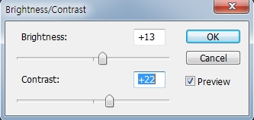
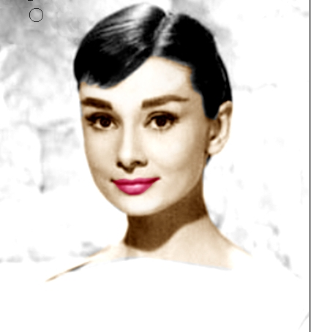
Black and white pictures to color pictures
For correcting the face contrast>Image>adjustment>
Control Brightness/Contrast>OK
By using Burn tool, dodge tool ,sponge tool
For making lighter: By using dodge tool
For making darker : By using Burn tool
For making the red area white: By using sponge tool

Slide 10
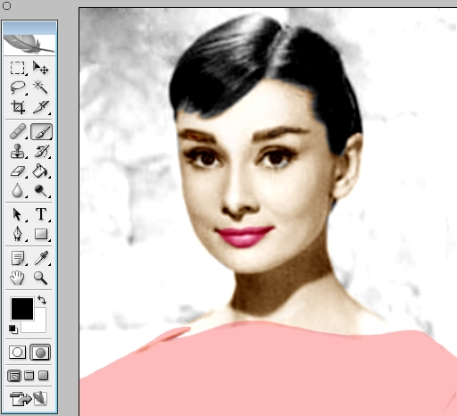
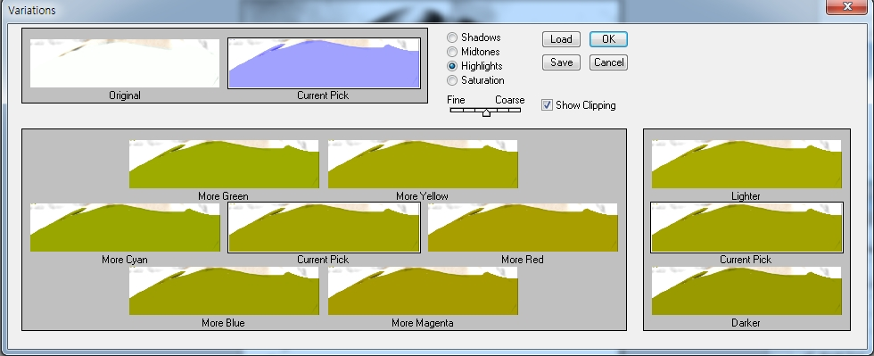
Black and white pictures to color pictures
In the standard mode, select the dress area by the lasso tool>Go to the Quick mask mode> Color the dress area by proper brush tool>
Go to standard mode
Image>Adjustment> Variations> Choose Original > Highlight>Click More Blue> Choose Saturation>More Saturation> OK> Ctrl+D

