Slide 1
Making GIF being moved to the right

Slide 2
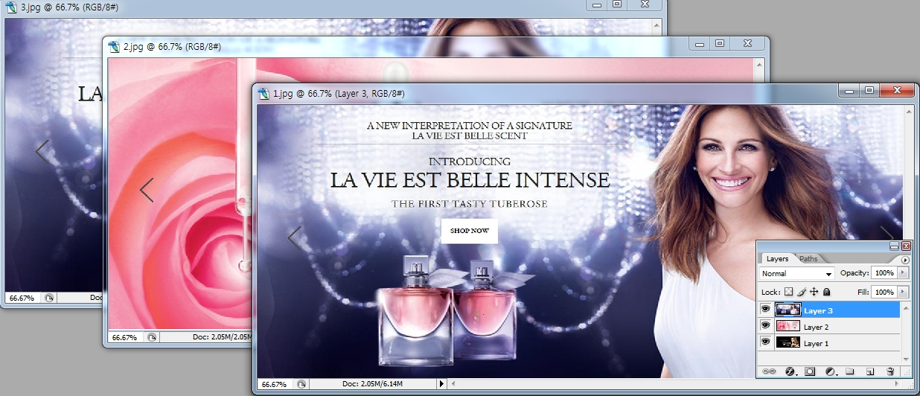
Making GIF being moved to the right
Open multiple copies of the same size picture
On layer1 >The Second photo(2.jpg)> CTRL+A >CTRL+C> On layer1 > CTRL+V
On layer 2> The Third photo(3.jpg)>CTRL+A >CTRL+C> On layer2> CTRL+V

Slide 3
Making GIF being moved to the right
WINDOW> Animation
When Animation 1, let photo of layer1 stay

Slide 4
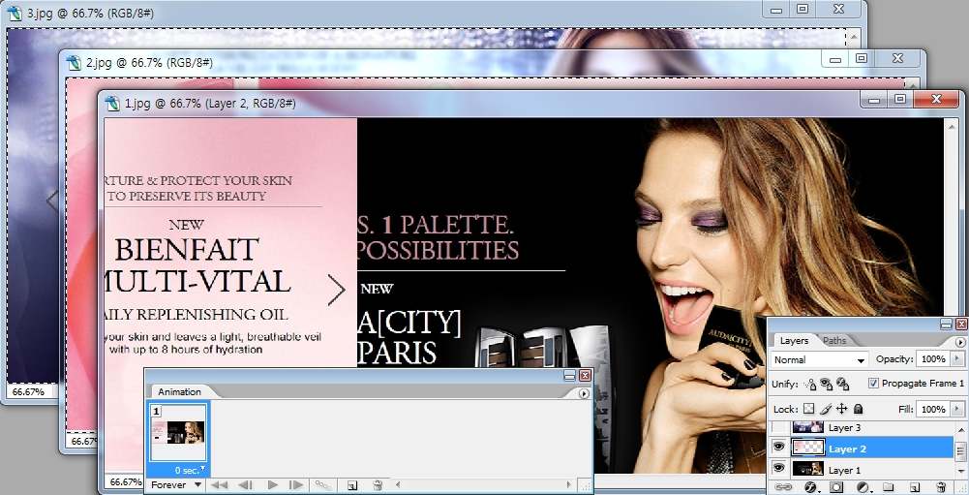
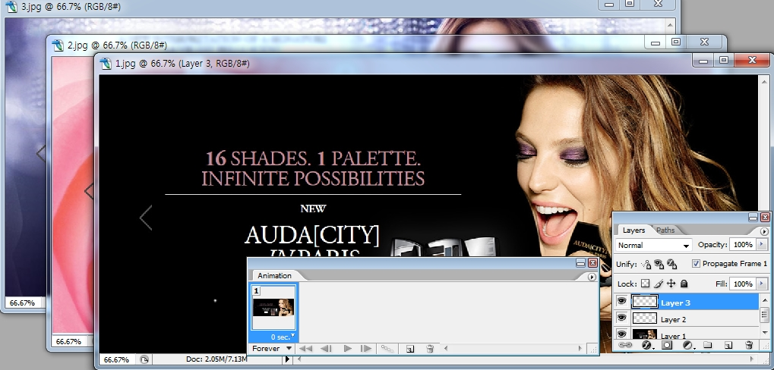
Making GIF being moved to the right
Click layer2> Press shift Key> Let layer2 be moved to the left
Click layer3> Press shift Key> Let layer3 be moved to the left

Slide 5
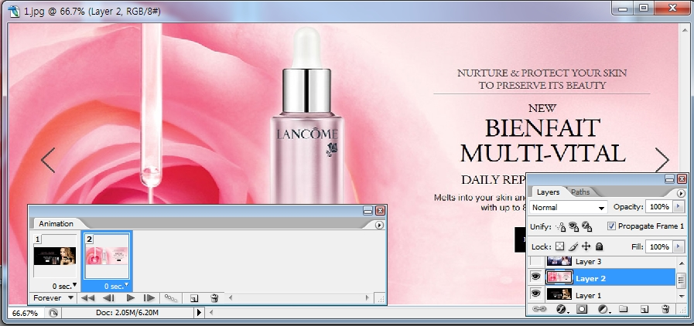
Making GIF being moved to the right
By using Dupulicates selected frame, add one frame.
Click layer2>click indicates layer2 visibility

Slide 6
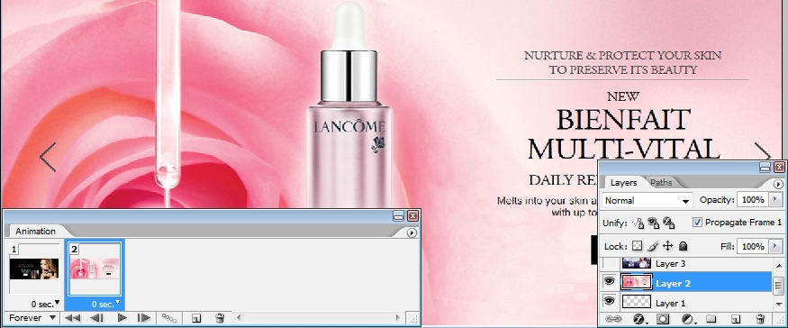
Making GIF being moved to the right
When Animation 2, let photo of layer1 be moved to the right
Press shift Key> let photo of layer2 show > Let layer3 stay at the left

Slide 7
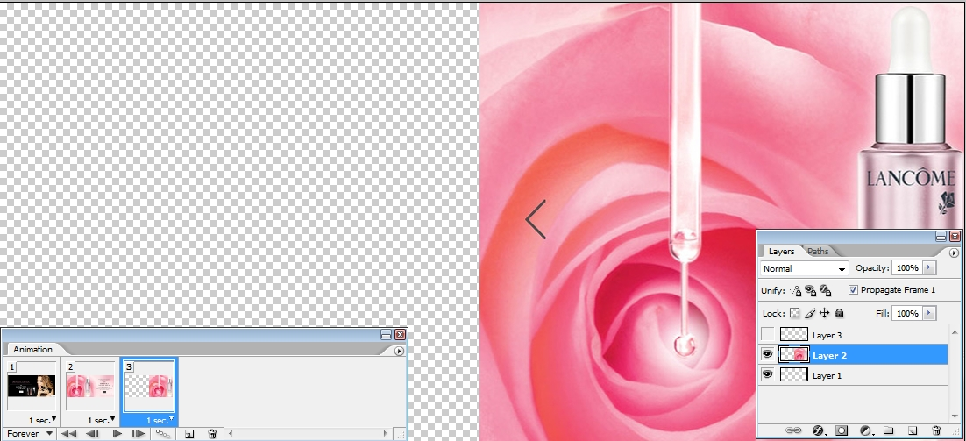
Making GIF being moved to the right
By using Dupulicates selected frame, add one frame.
Click layer3>click indicates layer3 visibility
When Animation 3> Press shift Key>Choose layer1> let photo of layer1 be moved to the right >Choose layer2> let photo of layer2 be moved to the right > Choose layer3> let photo of layer3 show

Slide 8
Making GIF being moved to the right
Choose layer3> let photo of layer3 show

Slide 9
Making GIF being moved to the right

Slide 10
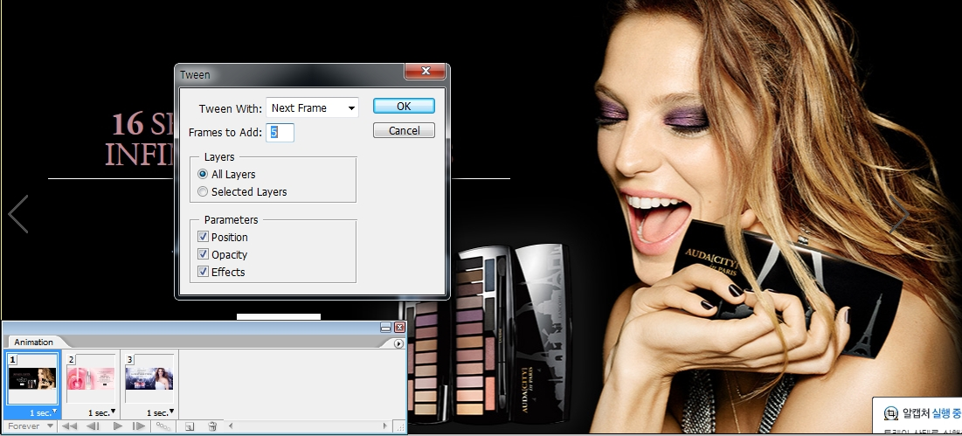
Making GIF being moved to the right
Click palette option> Click Tween> If you want 3 Frames to add between Animation1 and Animation2, write 3, If you want 5, write 5

Slide 11
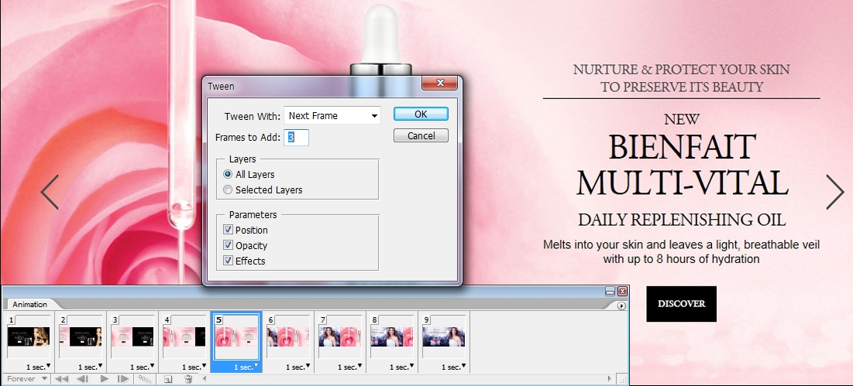
Making GIF being moved to the right
If you want 3 Frames to add between Animation2 and Animation3, write 3, If you want 5, write 5

Slide 12
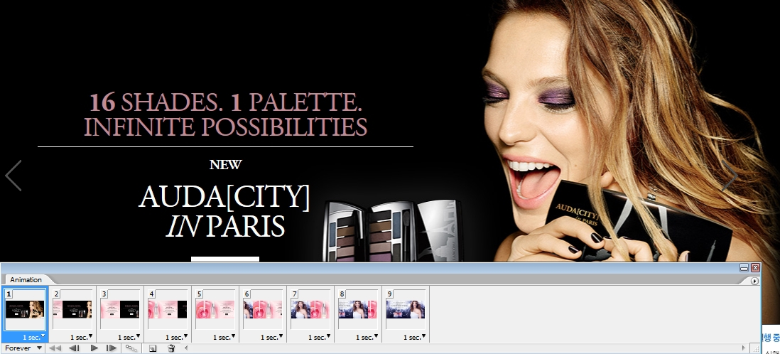
Making GIF being moved to the right
Press the Play button to confirm gif animation
Click sec of each frame and adjust the time

Slide 13
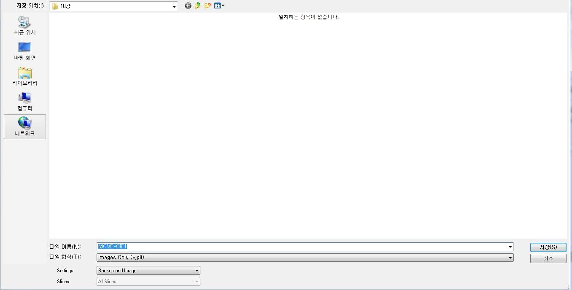
Making GIF being moved to the right
File>save for web>choose 128 color. Choose Format Html and image(html) Write FILE NAME, Absolutely Write the file name in English
file>save>choose format psd and save then you can add,fix

