Slide 1
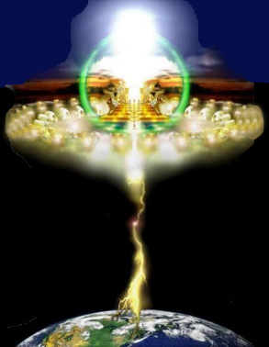
The Lord Is Present in His Sanctuary
The Lord is present in His sanctuary. Let us <praise> the Lord The Lord is present in His people gathered here. Let us <praise> the Lord. <Praise> Him, <praise> Him Let us <praise> the Lord <Praise> Him, <praise> Him Let us <praise> Jesus.
<delight>
<love>

