Slide 1
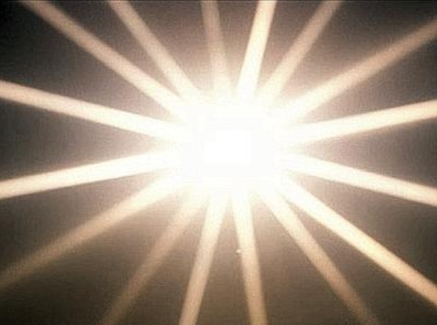
Let Your Glory Fall
Father of creation, unfold your sovereign plan Raise up a chosen generation
That will march through the land All of creation is longing
For your unveiling of power Would you release your anointing
Oh God let this be the hour
Ruler of the nations the world has yet to see The full release of your promise
The church in victory Turn to us Lord and touch us
Make us strong in your might Overcome our weakness
That we could stand up and fight
Let your glory fall in this room Let it go forth from here to the nations
Let your fragrance rest in this place As we gather to seek your face
Let your kingdom come Let your will be done
Let us see on earth The glory of your son

