Slide 1
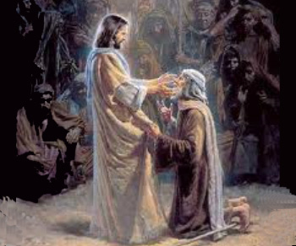
Jesus You Are My Healer
Jesus, Son of God Only You can save me
Suffering on the cross You gave Your all
Willingly paid the cost for me Now I am free to worship
Lord Your name is great A refuge I can run to
A shelter from the storm A faithful friend
And I can depend on You My God, my King I lift my voice and worship
O Jesus, Jesus O Jesus, Jesus, Jesus…
Refrain
Jesus, You are my healer O Jesus, touch me and I will be free
Lord by Your stripes I am healed O Jesus, You are my savior
O Jesus, You are my strength and my shield I put my trust
in Your name In Your name, Jesus

