Slide 1
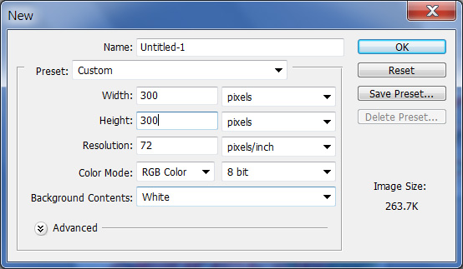
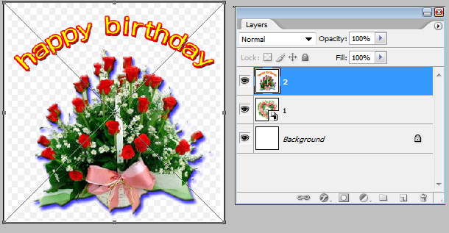
Moving GIF animation
- File>New>Record width
and Height’s pixel that
you desire
Choose File > Place>
Navigate to the file you want to insert and then double-click the file
Reposition the artwork by positioning your cursor inside the
bounding box and dragging.

Slide 2
Moving GIF animation
You can also transform (size, rotate and so on) your placed artwork if desired by dragging or rotating the handles on the bounding box or by entering values in the Options bar.
Be careful, however. If you enlarge your placed image too much, you may degrade the quality of your image.
Double-click inside the bounding box to commit the placed image to a new layer.
Do the same ways as above several times> You can place files and make new layers as you desire.

Slide 3
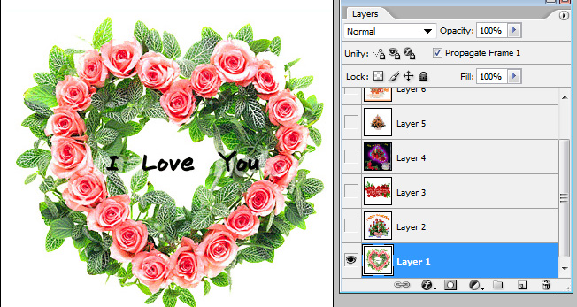
Moving GIF animation
Click the layer at the very bottom of the layers >Window>Animation
Click Duplicates Selected Frames> Make as many frames as you made layers

Slide 4
Moving GIF animation
In ANIMATION 1, open the layer 1 Visibility Icon

Slide 5
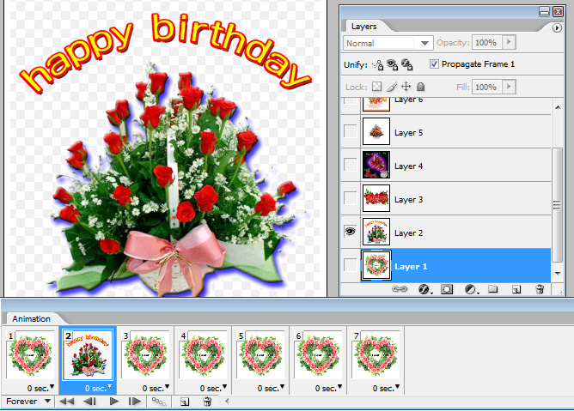
Moving GIF animation
In ANIMATION 2, open the layer 2 Visibility Icon

Slide 6
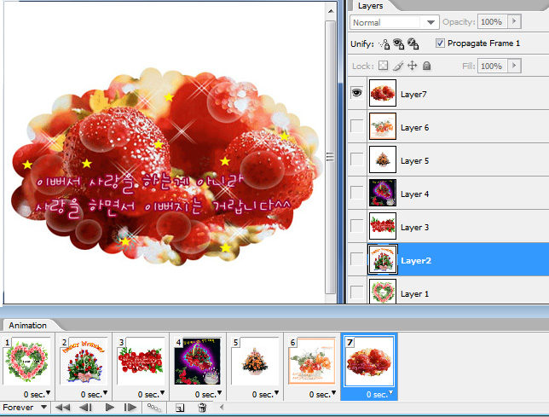
Moving GIF animation
In ANIMATION 3, open the layer 3 Visibility Icon
Do the same ways as above until the end.

Slide 7
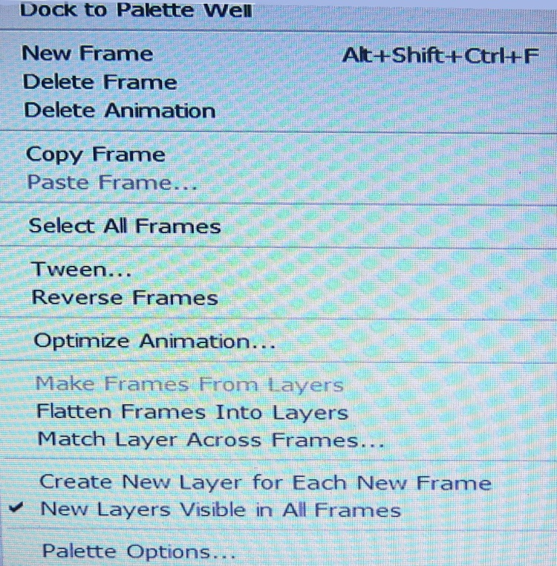
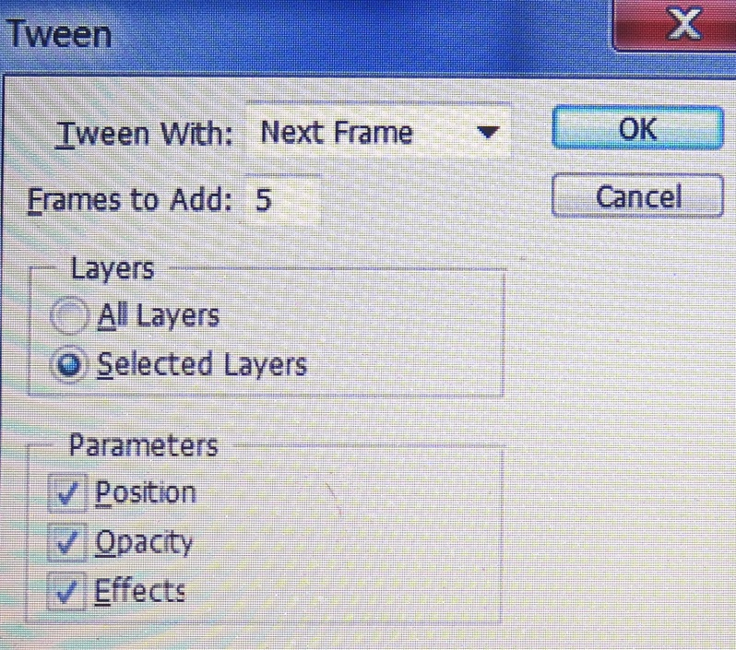
Moving GIF animation
Choose Animation 1, Choose tween among palette options
Between Animation 1 and Animation 2 , If you want 3 frames to add, record 3, If you want 5, record 5.

Slide 8
Moving GIF animation
From Animation 1 to Animation last, make as shown below by using tween. When you make tween to the last Animation frame, you need to copy the first frame, then paste it after the last frame. And make tween.
Press the Play button, make sure Gif animation.
Click each frame sec, adjust the timing.
File>save for web>save> choose color: Above 128.
Record file name and format. Absolutely write English.
Format: HTML and image(html).

Slide 9
Moving GIF animation

Slide 10
About Alpha Channel
Color Channel
Color information channels are created automatically when you open a new image. The image’s color mode determines the number of color channels created. For example, an RGB image has a channel for each color (red, green, and blue) plus a composite channel used for editing the image.
Show the information of the current color.
RGB (red, green, and blue) CMYK (Cyan, Magenta, Yellow, black)
B. Alpha channel
- You create a mask using your selection tools, such as the rectangular marquee tool, found in the Toolbox.
- The great thing about alpha channels is that they can be saved, tweaked, and
combined to apply effects to specific portions of your image. You can also save
your selections to a file and apply it to another file!
- Alpha channels define a selection in black, white. If you create an alpha channel from a saved selection, the channel most likely consists of just black or white pixels → White --- Part to work black --- Part not to work

Slide 11
About Alpha Channel
In alpha channels, selected pixels are white, the same concepts such as white part and white color part.
After making several Alpha channels, as the adding or subtracting a selection to adjust the concentration of white, and making the area , lastly you can apply for the effects at the RGB color channel.
In Alpha channels, you can save and bring about the selection area, then you can call again selection area that was saved, and apply images

Slide 12
Modifying an alpha channel's options
To modify the options for an alpha channel, follow th
1. Select the channel and then choose Channel Options from the palette options menu.
2. Enter a name for the alpha channel.
3. Specify the color and opacity of the overlay.
4. Specify whether you want the masked area (what the overlay will cover) to include the Masked Area (the unselected area), Selected Area, or Spot Color.
5. Click OK to close the Channel Options dialog box.

Slide 13
Saving a selection as an alpha channel
1. Make a selection in your image.
2. Choose Select --> Save Selection.
3. Choose a destination image in the Document pop-up menu.
4. Choose a destination channel from the Channel pop-up menu.
5. If you choose New, name the channel.
6. If you choose an existing channel or layer mask, select your desired combination.
7. Click OK.

Slide 14
Loading an alpha channel
Choose Select --> Load Selection. Select your document and channel. Click Invert to swap selected and unselected areas. If your image has an active selection, choose how you want to combine the selections.
Select the alpha channel in the Channels palette, click the Load Channel as Selection button at the bottom of the palette, and then click the composite channel.
Drag the channel to the Load Channel as Selection icon.
Ctrl+click (Command key+click on the Mac) the alpha channel in the Channels palette.
Ctrl+Shift+click (Command key +Shift+click on the Mac) to add the alpha channel to an active selection.
Ctrl+Alt+click (Command key +Option+click on the Mac) to subtract the alpha channel from an active selection.
Ctrl+Alt+Shift+click (Command key +Option+Shift+click on the Mac) to intersect the alpha channel with an active selection

