Slide 1
Making Menubar for Homepage
  Menubar Production Procedure
  Basic look production by Shape tool
  Style application
  by layer Style
  3) Menu copy
  Text input
  Roll over menu Design
  Layer Style Option
Drop Shadow
Inner shadow:Luminous effect
(Neon effect)
Bevel and Emboss:
Stereo effect
Satin: Texture effect
Color Overlay:Color painting
Gradient Overlay:
Gradient fill
Pattern Overlay: Pattern fill
Stroke : Border effect

Slide 2

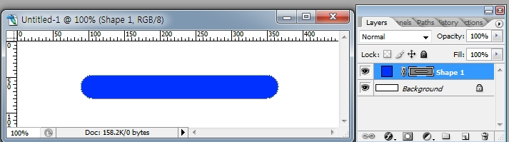
Making Menubar for Homepage
  Making Menubar
  1) New>450x120 px
  2) Rounded rectangle tool>Shape layer> Radius:30 > Making Rounded rectangle
  Absolutely choose Shape layer
  Add a Layer style > Drop shadow, Inner Glow, Pattern overlay

Slide 3
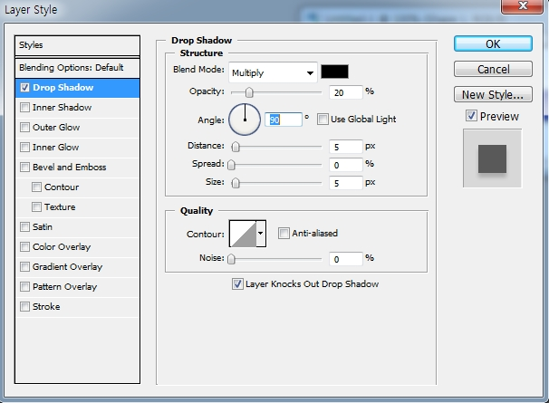

Making Menubar for Homepage
  Drop shadow>
  Multiply black
  Opacity:20%
  Distance:5%
  Spread :0%
  Size :5%
  Use global light :No check
  Angle:90°
  Contour: Choose one among 12 graph shadow styles

Slide 4
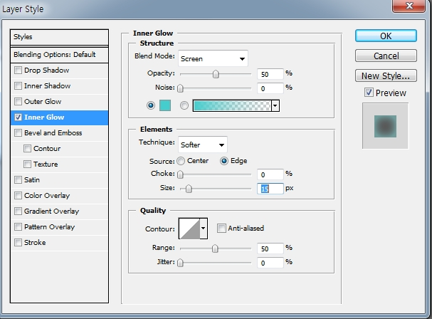
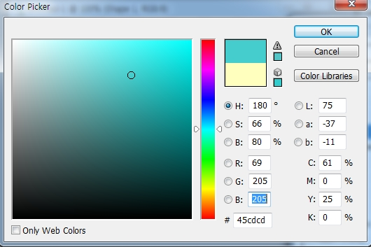
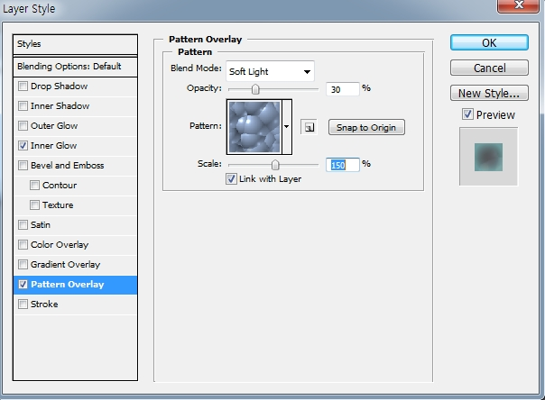

Making Menubar for Homepage
  For shadow to come inside
  Inner Glow
  R:69 G:205 B:205
  Opacity : 50%
  Size : 15%
  7) Click Pattern Overlay
  Blend mode: soft light
  Pattern: Choose this
  Opacity :30%
  Scale: Around 150%

Slide 5

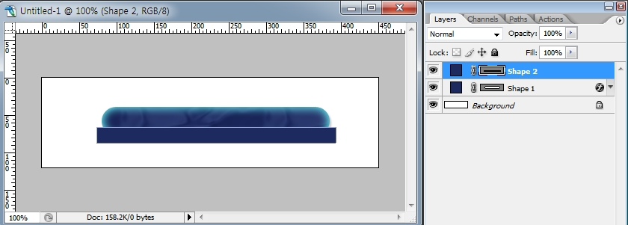
Making Menubar for Homepage
  New style>ok>ok
  Foe making shadow> Making rectangle shape by rectangle tool
  For making warp> edit> free Transform path

Slide 6
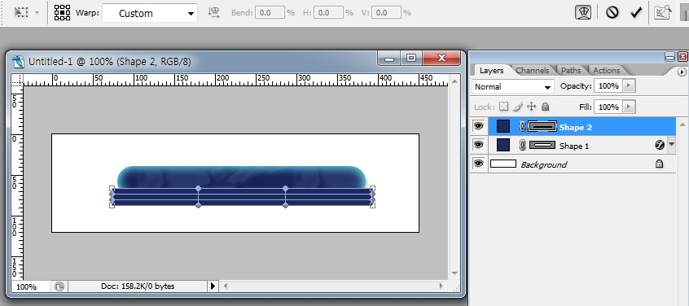
Making Menubar for Homepage
  Click warp> Custom appears>Click custom>
  Choose ARC >For changing curvature >Bend:-6>
  APPLY

Slide 7
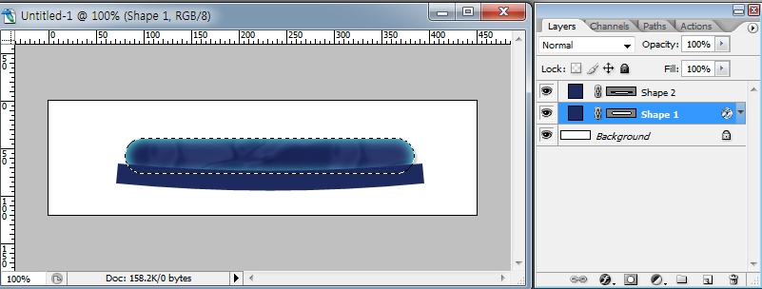
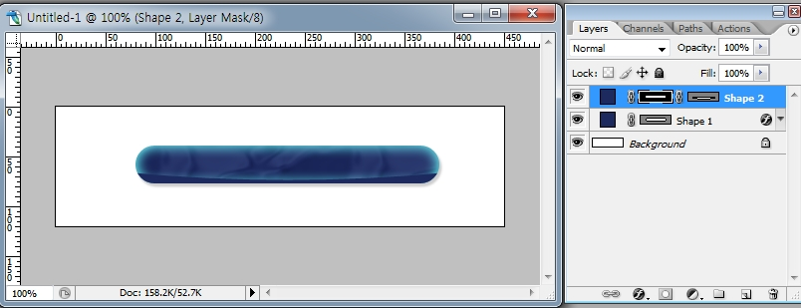
Making Menubar for Homepage
  Choose SHAPE1 Layer+ Click CTRL
  Move the cursor at the shape2>Choose Add layer mask

Slide 8
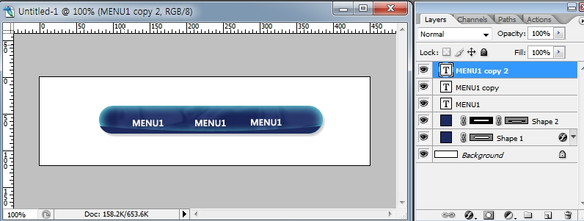
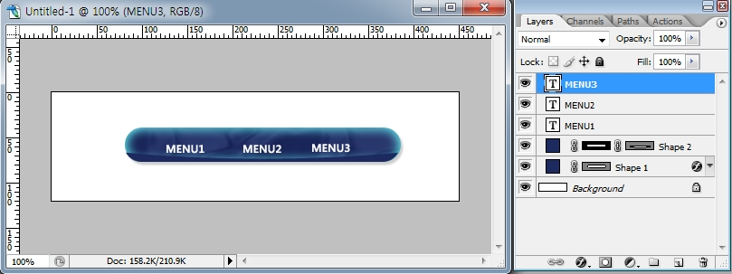
Making Menubar for Homepage
  14) Choose the top layer> Record Text (EX MENU1)
  Set Anti-aliasing method: STRONG
  15) CTRL+J : TWICE>REWRITE MENU2, MENU3

Slide 9
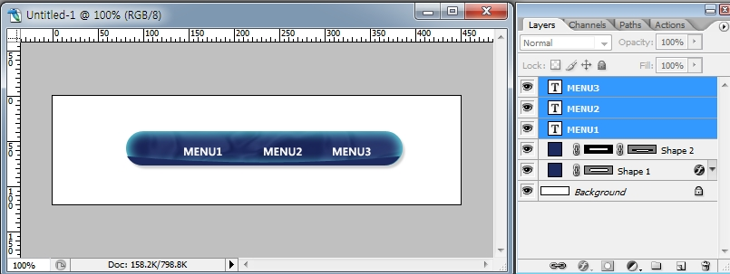

Making Menubar for Homepage
  16)For Text Align> Choose 3 text layers> Choose Move Tool
  17)For distributing horizontal centers> Choose distribute horizontal
  centers

Slide 10
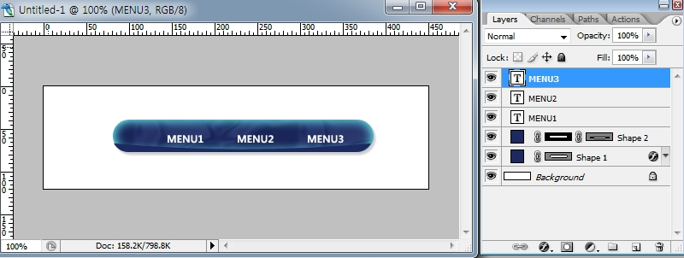
Making Menubar for Homepage
  18)For changing menubar color> Choose adjustment layer
  19) Choose HUE SATURATION

Slide 11
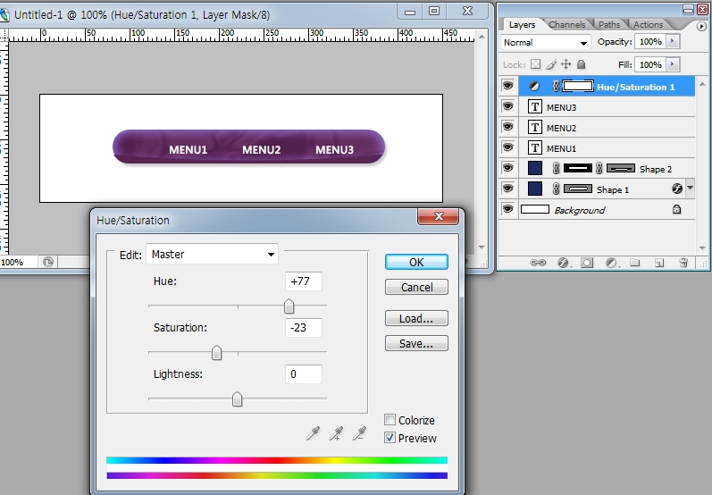
Making Menubar for Homepage
  20) Change HUE data>Then can change menubar color

