Slide 1
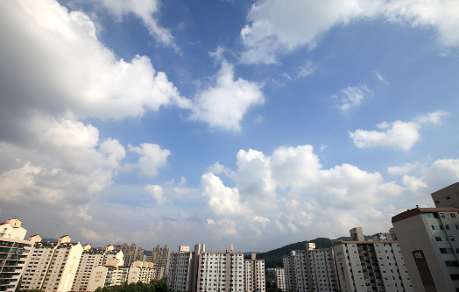
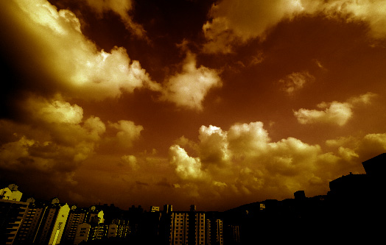
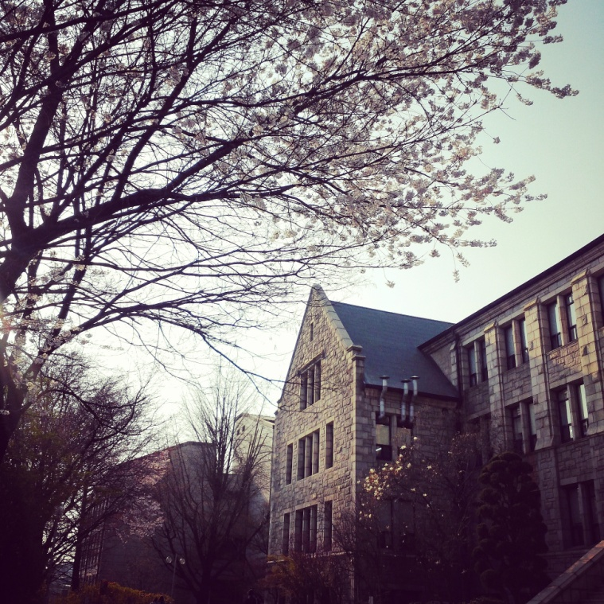
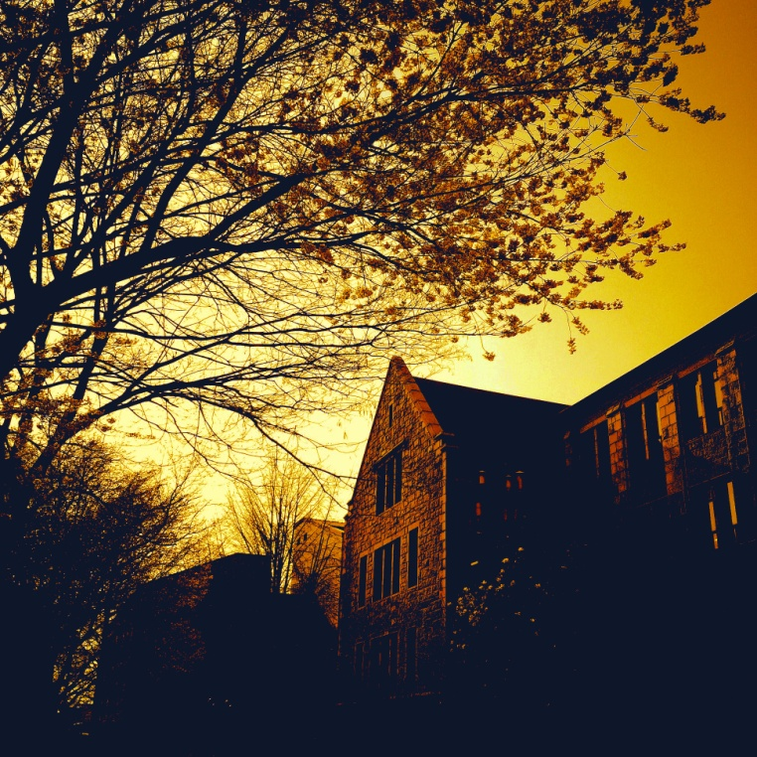
Silhouette Photo Effect

Slide 2
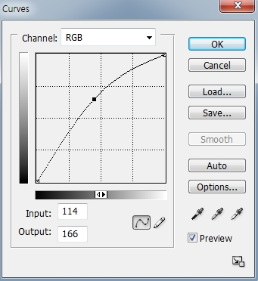
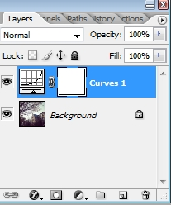
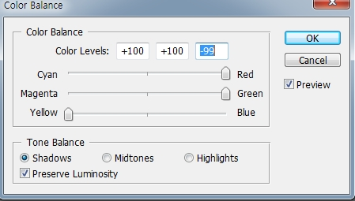
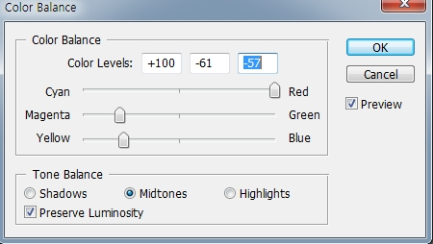
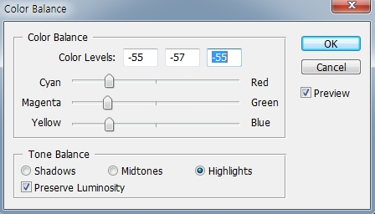
Silhouette Photo Effect
File>open
Layer>new Adjustment layer> Curve>Drag to the upper side
layer> New Adjustment Layer>Color Balance
Shadow : Cyan(Toward Red), Magenta(Toward Green), Yellow(Toward Yellow)
Midtones: Cyan(Toward Red), Magenta(Toward Left), Yellow(Toward Left )
Highlight: Cyan(Toward Left ), Magenta(Toward Left ), Yellow(Toward Left)

Slide 3
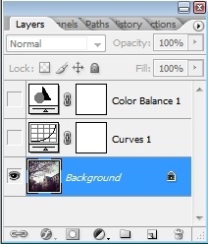
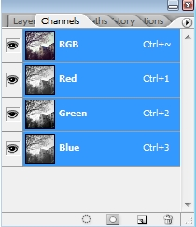
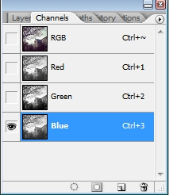
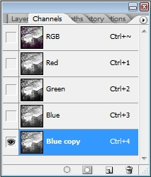
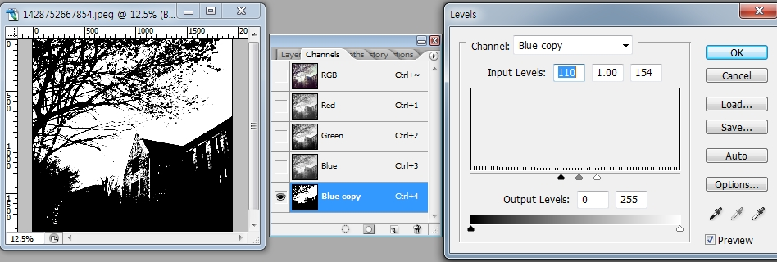
Silhouette Photo Effect
For making Silhouette,
Choose background layer, Check only Background layer ,Uncheck color balance, curve indicates layer visibility > Choose the channel>Choose blue>Drag Blue and put on the create new channel
- Made blue copy channel
- On Blue copy channel> image> adjustment>level
- Move BLACK AND WHITE LEVEL
To the center

Slide 4
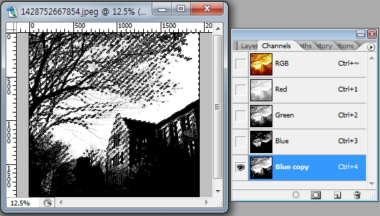
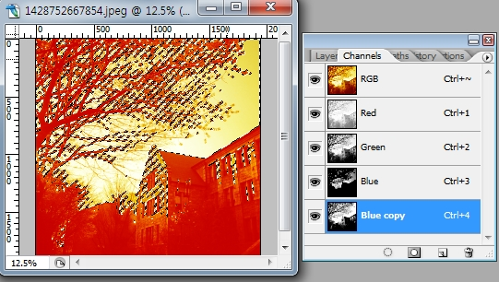
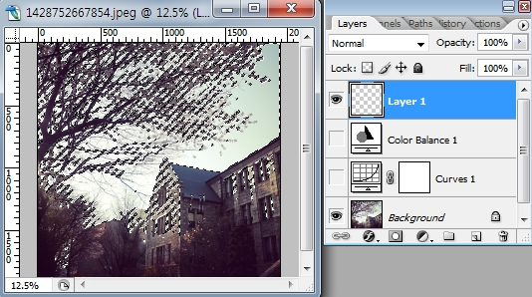
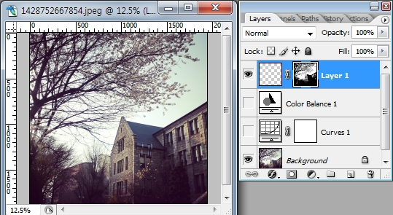
Silhouette Photo Effect
At the same time, press ctrl key + Blue copy channel>Click the RGB channel
Return to the LAYER> Add new layer on the Color balance layer
At the new layer>Add Layer Mask> Choose mask thumbnail> CtRL+I

Slide 5
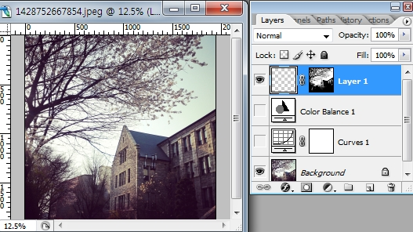
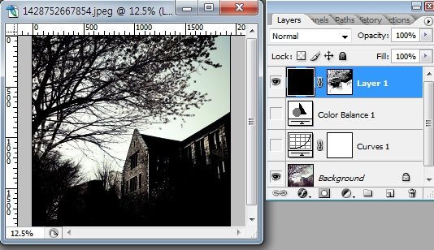
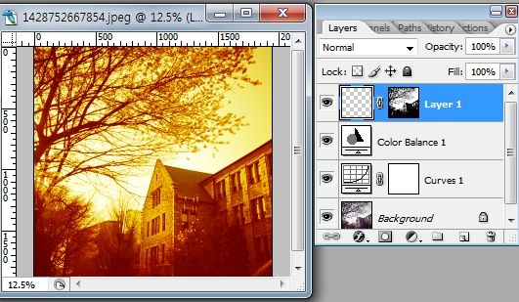
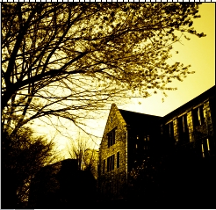
Silhouette Photo Effect
Choose image thumbnail> Foreground:black, background:white>For filling the background> AIT+DELETE
Click All indicates layer visibility

