Slide 1
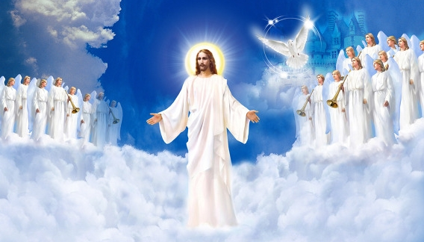
We Sing Alleluia
There's an anthem ringing out You can hear it clear and loud
Coming from the hearts of men Echoing the Great I Am
And it goes on and on and on and never fades away
On and on and on and so we join today
There's a song that never dies It lives within the heart that cries
Out for mercy on the streets It's a cry of love and harmony
And it goes on and on and on and never fades away
On and on and on and so we join today
Men have praised You Through the ages
Followers who have gone before us So we stand before You
And we lift our voices All together we join the chorus
Refrain
We sing alleluia Praise Your name and glorify
We sing alleluia Lift our voices to the sky

