Slide 1
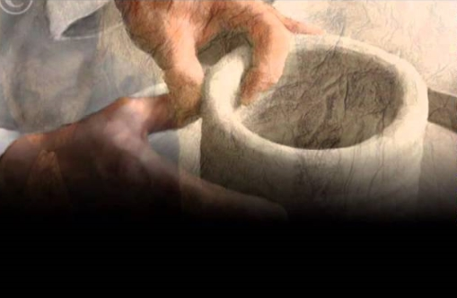
For Who You Are
Standing here in Your presence Thinking of the good things You have done
Waiting here patiently Just to hear Your still small voice again
Holy, righteous, faithful till the end Savior, healer, redeemer and friend
My soul's secure, Your promise sure Your love endures always
My soul's secure, Your promise sure Your love endures always
My soul's secure, Your promise sure Your love endures always
Refrain
I will worship You for who You are I will worship You for who You are
I will worship You for who You are Jesus

