Slide 1
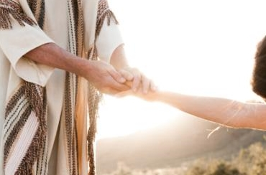
Living for Jesus, Oh What Peace
1. Living for Jesus, oh, what peace! Rivers of pleasure never cease;
Trials may come, yet I’ll not fear, Living for Jesus, He is near.
2. Living for Jesus, oh, what rest! Pleasing my Savior, I am blest;
Only to live for Him alone, Hear from His lips, “My child, well done!”
Refrain
Help me to serve Thee o’er and o’er;
Help me to praise Thee more and more,
Live in Thy presence day by day,
Never to turn from Thee away.

