Slide 1
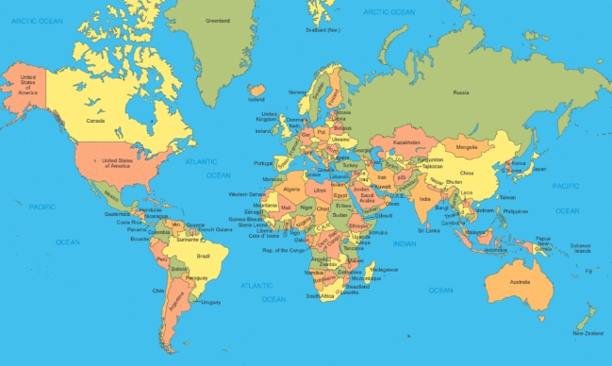
Christ for the Whole Wide World
Christ for the whole wide world! Our task has just begun, For millions wait in every land The message of God's Son. Shall they be left in sin, To die without His Word, Without the Savior Jesus Christ, Because they never heard?
Christ for the whole wide world! His message must be sent To millions dying in their sin To call them to repent. Christ Jesus died to save, But they can never know Until we bring our gifts of love And bid His heralds go!
Christ for the whole wide world! His heralds will proclaim Salvation for men everywhere In Jesus' blessed name. And we who cannot go To bear His tidings far Will pray for those who take the Word, And witness where we are.
Refrain
We will give, we will pray, We will witness every day,
That the millions of the whole wide world May know our Savior's love.

