Slide 1
Use of dodge tool, burn tool, sponge tool
Dodge tool : Making selected areas lighter
Keyboard shortcut:
When using dodge tool, or choosing dodge tool , O
Burn tool : Making selected areas darker
shortcut: During using dodge tool+ ALT drag
Sponge tool : Adjusting Saturation
Saturation increase : SATURATION
Saturation decrease : DESATURATION

Slide 2
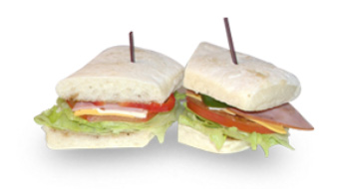
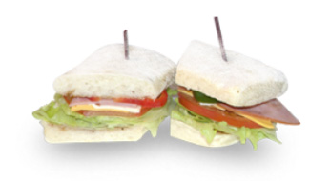
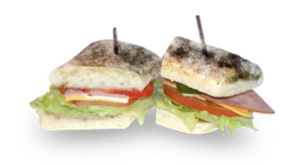
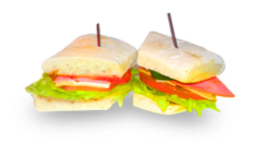
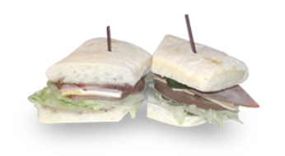
Dodge
tool
Burn tool
Sponge
tool :
SATURATION
DESATURATION

Slide 3
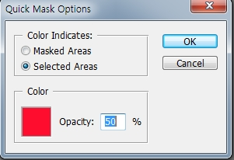
Dyeing and changing hair style
- Dragging only hair with Magic Wand Tool> Click quick
mask mode twice, check selected Areas, color: red,
opacity:50%> with brush, Color only hair red
carefully in quick mask mode> After finishing, go to
standard mode
- Layer > New Adjustment layer> Color balance:
red color level +10, Magenta color level -10,
yellow color level -100 > OK> Opacity: Around 90%, check (highlight, preserve luminosity)

Slide 4
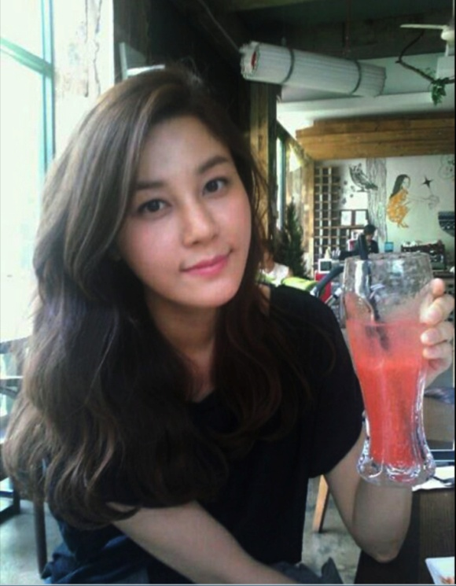
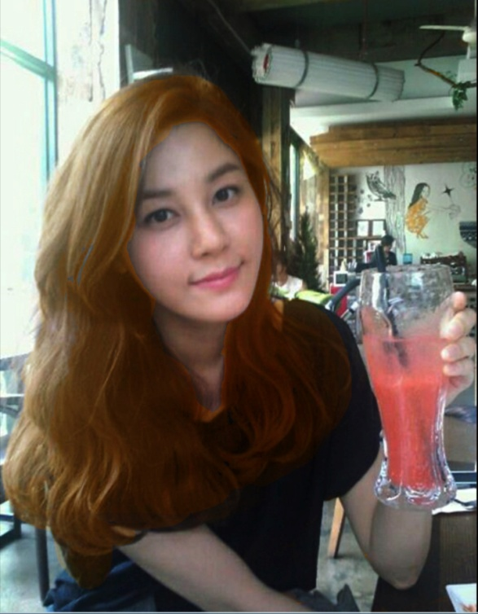
Dyeing and changing hair style

