Slide 1
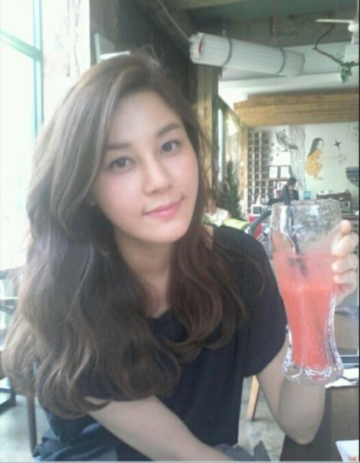
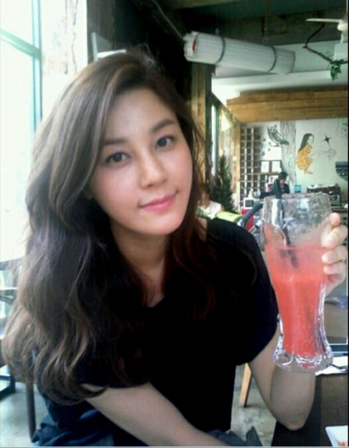
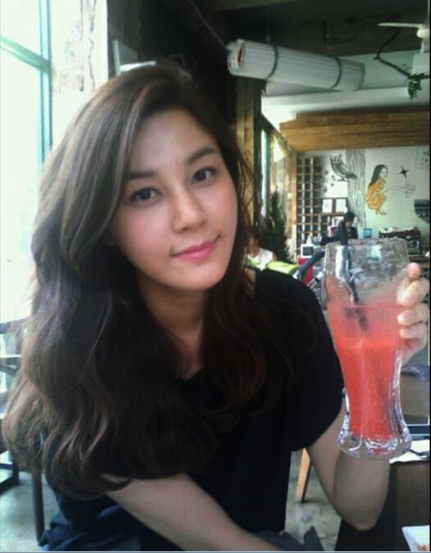
Clearer Photo
1. Two ways of making photo
clearer Image>adjustments>
curves, or level
(original image Irreversible)
- Layer> new adjustment
layer> curves, or level
(original image
reversible)
Use level
Use curve

Slide 2
Clearer Photo
Increase of black color
Control of all shade, saturation
Increase of white color

Slide 3
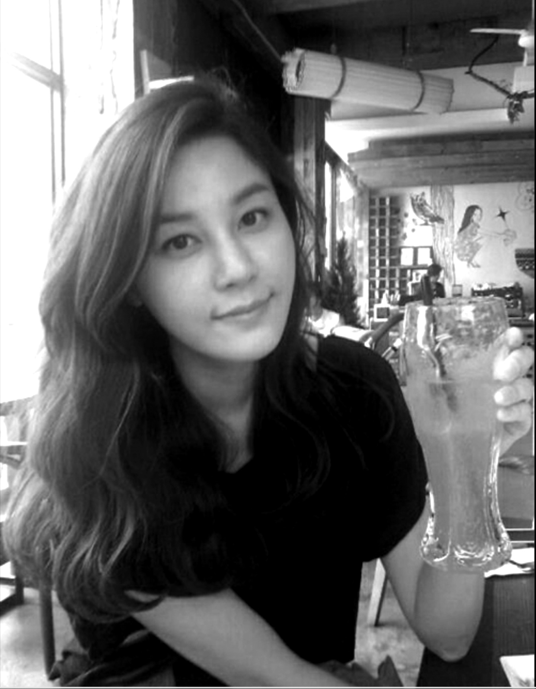
Convert a color image to black and white
Image>Mode>Grayscale
Layer> New adjustment layer> Curve, or level

Slide 4
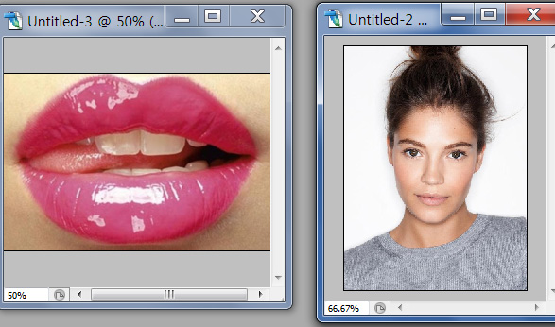
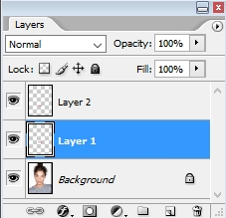
Making moisty lips
- Open two files (One moisty lips and one photo)
- Dragging upper lip with lasso tool , copy it and paste it
on the layer1 above background layer.
- Add layer
- Dragging bottom lip with lasso tool , copy it and paste it
on the layer2.

Slide 5
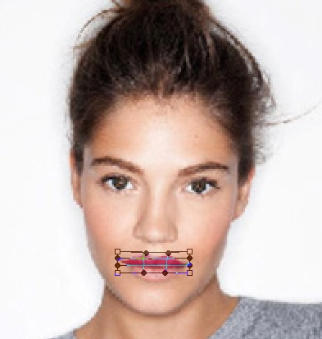
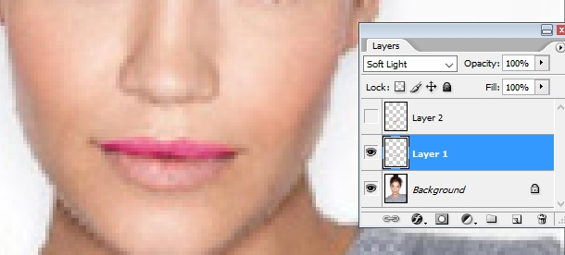
Making moisty lips
Edit > transition > Scale and Warp,
Making upper lip similar to
one photo lip
- Blend mode: Soft Light
- Lock: Lock transparent pixels,
- Foreground color:Choose
higher saturated color than
background girl lip color,
- Brush: Mode:color,
flow: make flow lower as 15%, rub the upper lip.

Slide 6
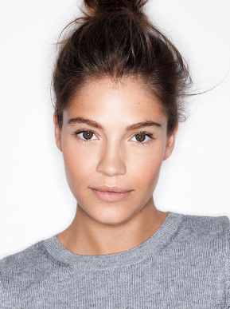
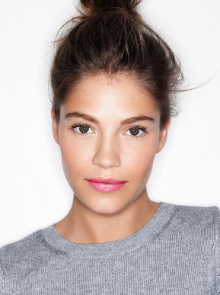
Making moisty lips
- Perform the same process at the bottom lip

