Slide 1
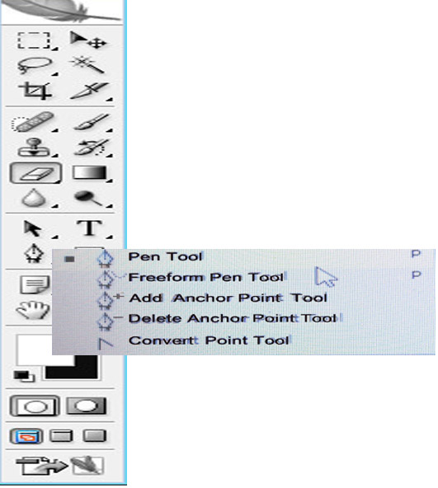
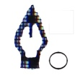
Pen tool
Alt : Can change one direction
Ctrl : Can change both direction
Ctrl + Enter : If u want to choose path by using the Pen Tool
: To close the path, can connect the beginning point.
Add Anchor point
Delete Anchor point
Create a new work path
Exclude overlapping
path area
Subtract from path area
Shape layer
Add to path area
path
Intersect path area

Slide 2
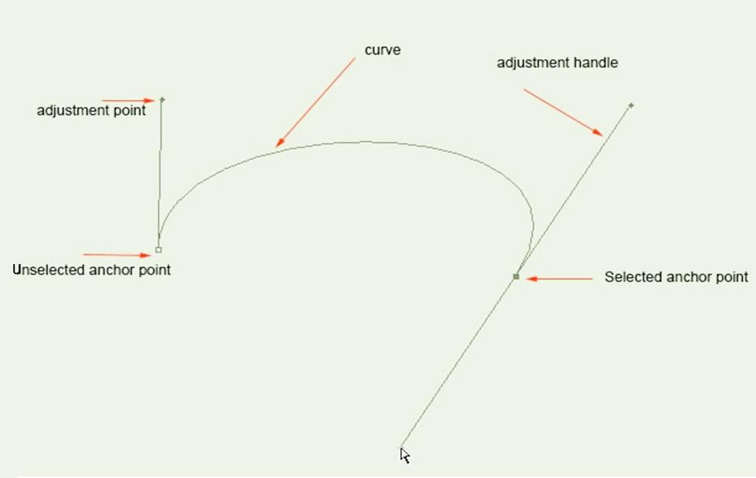
Path tool

Slide 3
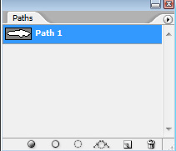
Path tool
Whenever draw the line with the pen tool, the new path appears as the work path in the Paths panel.
Path is a line with anchor points at either end.
More-complex paths are made up of multiple segments, each with an anchor point at either end.
Path can be a straight line or it can be curved, depending on how you create it.
Work path appears as blue. If click the blank , blue disappears.
Ctrl + Work path + Mouse Left Button Click– Then the selection tool appears.
Work paths are temporary vector paths. To save a work path, double-click the path in the Paths panel. After you save your path, you can reload it at any time. When save a new name path, and save jpg or psd file, can reload and use.

Slide 4
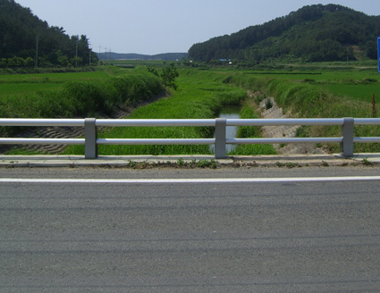
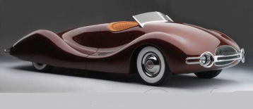
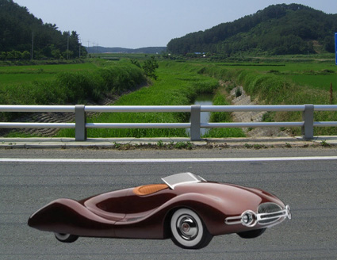
Composite photograph with Pen Tool
1
2
File>Open two photos
On the 1 photo,
click the only car with pen tool.
2. Ctrl+ Work path + Mouse Left Button Click
3. The selection tool of the car Ctrl+ C
On the 2 photo, Ctrl+ V

Slide 5
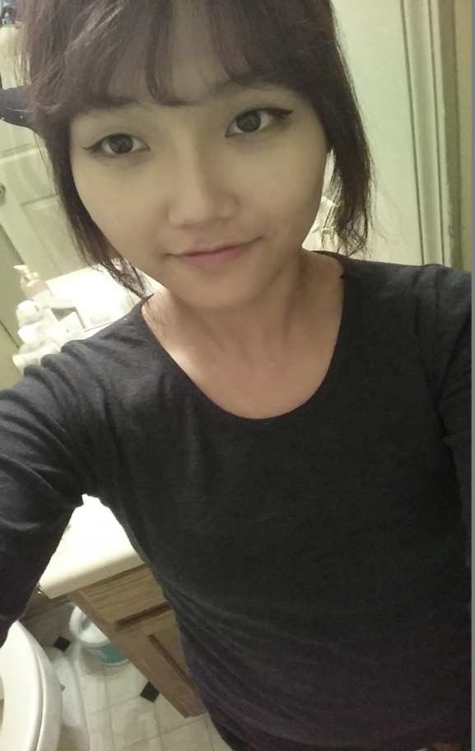
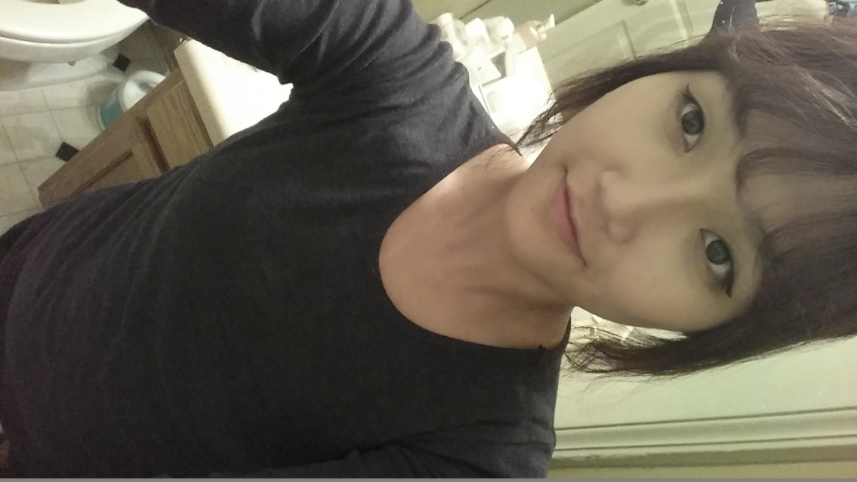
Upside-down photo, Rotate and flip
File>Open
Choose photo> image> Rotate Canvas
180 , 90 CW(clockwise rotation),
90CCW(counterclockwise rotation )
Flip canvas Horizontal(direction of right and left )
Flip canvas Vertical(up and down direction)

