Slide 1
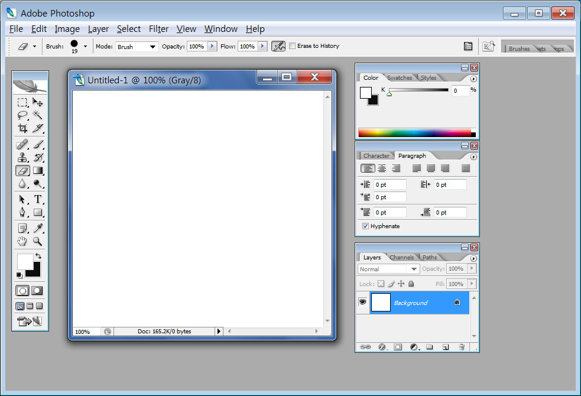
Adobe Tutorial & Making identification photo
Menu bar
Option bar
Displaying window:
Minimizing,
Maximizing, Close or Exit Button
Image window
Tool bar
Palette

Slide 2
Adobe cs Tutorial
MARQUEE TOOL
MOVE TOOL
LASOR TOOL
MAGIC WAND TOOL
CROP
SLICE TOOL
SPOT HEALING BRUSH TOOL
BRUSH TOOL
STAMP TOOL
GRADIENT
Eraser
TEXT
Pen tool
Eyedropper tool
Foreground color
Zoom tool
Background color
Standard Mode
Quick Mask Mode
Adobe Imageready
Adobe Photoshop

Slide 3
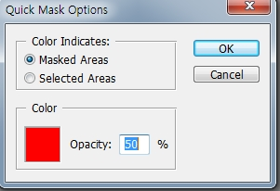
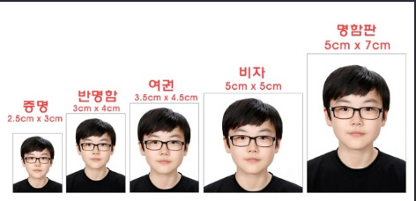
visa
Making identification photo
1. File>Open one photo
2. Cropping unnecesary parts by using crop tool,
3. Distinguishing between identification photo part and
background part of photo>
by using lasso tool and Magic Wand Tool,
click background part
Click quick mask mode twice, check Masked Areas >color click>choosing red color>opacity 50%>coloring background part red carefully
4. Going to standard mode, adding one Layer
5. In the Layer2, after choosing background color and foreground color, making Gradient
6. In the Layer2, Filter> Render> Cloud and, Filter> Render> Lens Flare
deciding brightness, Lens type: 50-300mm Zoom
7. For making clearer photograph, Layer>New Adjustment Layer>
using Curves, Level
8. File>Automate>Picture Package> identification photo 2.5X3>OK
card-sizeed
photograph
Passport
photos
Visa
3X4 photo
identification

Slide 4
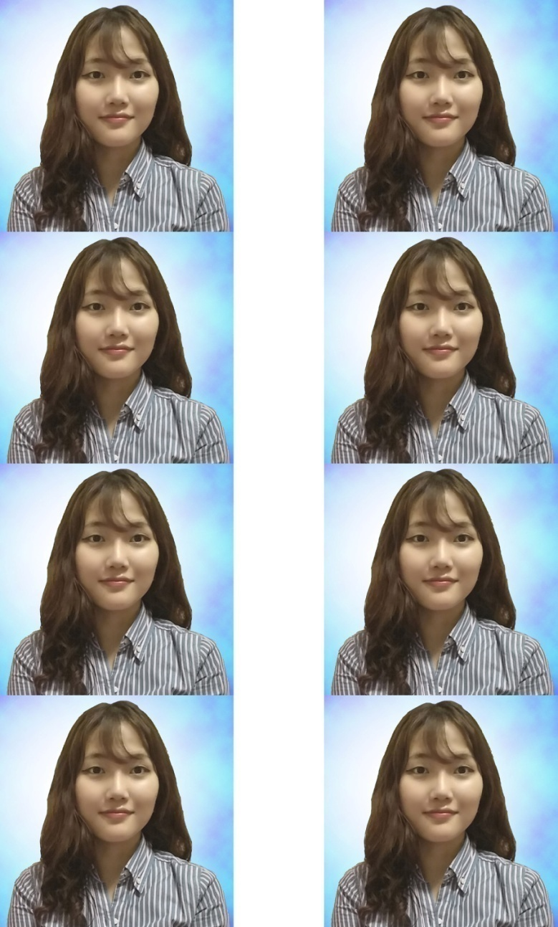
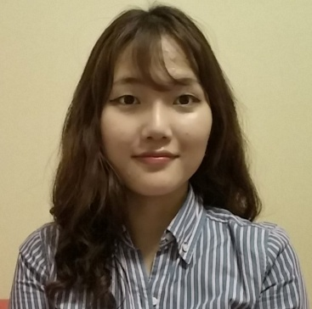
Identification photo

