Slide 1
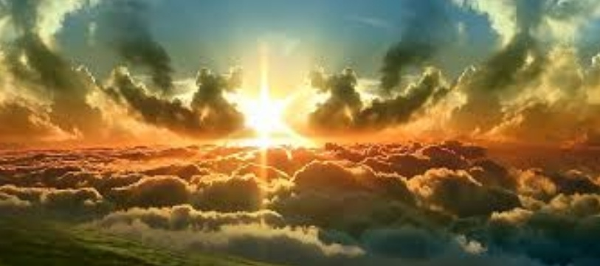
Praise the Lord, His Glories Show
1. Praise the Lord, His glories show, Alleluia! Saints within His courts below, Alleluia! Angels ‘round His throne above, Alleluia! All that see and share His love, Alleluia!
2. Earth to heaven and heaven to earth, Alleluia! Tell His wonders, sing His worth, Alleluia! Age to age and shore to shore, Alleluia! Praise Him, praise Him evermore! Alleluia!
3. Strings and voices, hands and hearts, Alleluia! In the concert play you parts; Alleluia! All that breathe, you Lord adore, Alleluia! Praise Him, praise Him evermore! Alleluia! Amen

