Slide 1
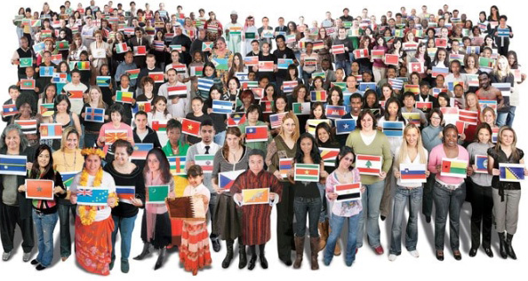
Once to Every Man and Nation
1. Once to ev'ry man and nation Comes the moment to decide,
In the strife of truth and falsehood, For the good or evil side; Some great cause, some great decision,
Off'ring each the bloom or blight, And the choice goes by forever 'Twixt that darkness and that light.
2. By the light of burning martyrs, Christ, Thy bleeding feet we track,
Toiling up new Calv'ries ever With the cross that turns not back;
New occasions teach new duties, Ancient values test our youth;
They must upward still and onward, Who would keep abreast of truth.

