Slide 1
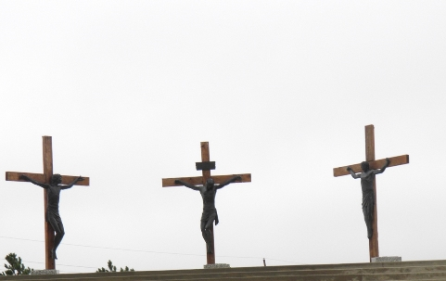
Marvelous Grace of Our Loving God
1. Marvelous grace of our loving Lord, grace that exceeds our sin and our guilt,
yonder on Calvary's mount out-poured, there where the blood of the Lamb was spilt.
2. Sin and despair, like the sea waves cold, Threaten the soul with infinite loss;
Grace that is greater, yes, grace untold, Points to the refuge, the mighty cross.
3. Marvelous, infinite, matchless grace, freely bestowed on all who believe;
you that are longing to see his face, will you this moment his grace receive
Refrain:
Grace, grace, God's grace, grace that will pardon and cleanse within;
grace, grace, God's grace, grace that is greater than all our sin.

