Slide 1
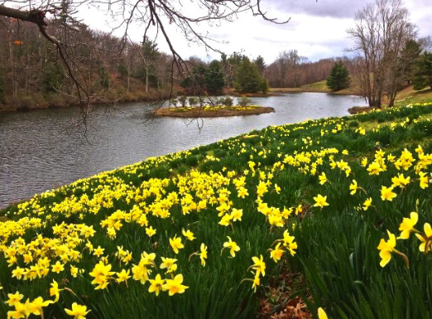
I've Cast Heavy Burdens Down
I’ve cast my heavy burdens down on Canaan’s happy shore,
I’m living where the healing waters flow;
I’ll wander in the wilderness of doubt and sin no more;
I’m living where the healing waters flow.
2. With Israel’s trusting children I’m rejoicing on my way,
I’m living where the healing waters flow;
The cloudy fiery pillar is my guiding light today; I’m living where the healing waters flow.
3. My hung’ring soul is satisfied with manna from above,
I’m living where the healing waters flow;
No more I thirst, the rock I’ve found, that fount of endless love;
I’m living where the healing waters flow.
Refrain
Living on the shore, I’m living on the shore, I’m living where the healing waters flow; (x2)

