Slide 1
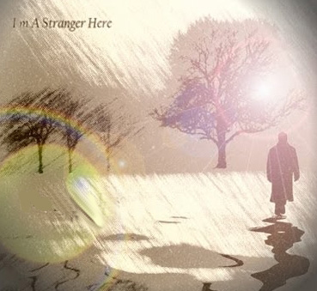
I am a stranger here
I am a stranger here, within a foreign land;
My home is far away, upon a golden strand;
Ambassador to be of realms beyond the sea,
I’m here on business for my King.
This is the King’s command: that all men, everywhere,
Repent and turn away from sin’s seductive snare;
That all who will obey, with Him shall reign for aye,
And that’s my business for my King.
Refrain:
This is the message that I bring, A message angels fain would sing;
"Oh, be ye reconciled,” Thus saith my Lord and King,
"Oh, be ye reconciled to God."

