Slide 1
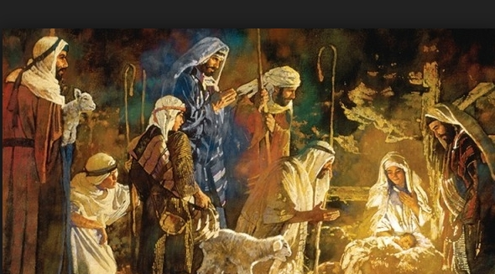
God Rest Ye Merry Gentlemen
God Rest Ye Merry, Gentlemen, Let nothing you dismay; Remember Christ, our Savior, Was born on Christmas day, To save us all from Satan's power When we were gone astray. From God our Heavenly Father, A blessed Angel came; And unto certain Shepherds Brought tidings of the same: How that in Bethlehem was born The Son of God by Name And when they came to Bethlehem Where our dear Savior lay, They found Him in a manger, Where oxen feed on hay ; His Mother Mary kneeling down, Unto the Lord did pray
Now to the Lord sing praises, All you within this place, And with true love and brotherhood Each other now embrace; This holy tide of Christmas All other doth deface.
Refrain O tidings of comfort and joy, Comfort and joy, O tidings of comfort and joy

