Slide 1
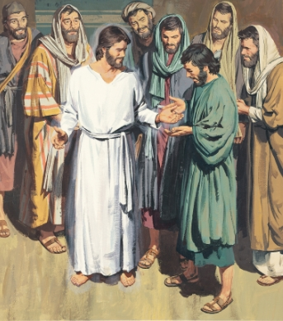
Because He lives I can face tomorrow
1. God sent His son, they called Him Jesus
He came to love, heal, and forgive. He lived and died to buy my pardon,
An empty grave is there to prove my Savior lives.
2. How sweet to hold a newborn baby,
And feel the pride and joy he gives.
But greater still the calm assurance,
This child can face uncertain days because He lives.
3. And then one day I'll cross the river,
I'll fight life's final war with pain.
And then as death gives way to victory,
I'll see the lights of glory and I'll know He lives.
Refrain
Because He lives, I can face tomorrow. Because He lives, All fear is gone! Because I know He holds the future And life is worth the living just because
He lives!

