Slide 1
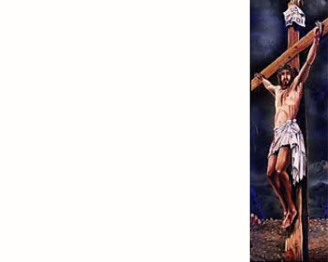
We Glorify Your Name
Maker of the heavens Master of the seas
Mover of the mountains Majesty
We glorify Your Name(x3) In all the earth
Awesome God in power Author of my life
All consuming fire Alive Alive
You are seated on a throne of praise
Unto You alone Let our voices raise(x2)
The highest praise is Yours(x3) in all the earth

