Slide 1
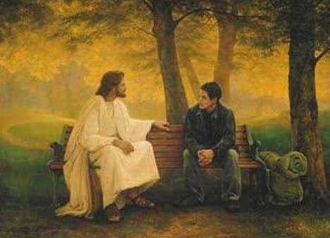
Since Christ My Soul From Sin Set Free
1. Since Christ my soul from sin set free, This life has been a joy to me;
And ’mid earth’s sorrows and its woe, Tis joy my Jesus here to know.
2. The earth was once a bitter place Till Jesus showed His smiling face;
Now joy’s begun within my soul , ’Twill last while endless ages roll.
3. What matters where on earth we dwell?
On mountain top, or in the dell, In cottage, or a mansion fair,
Where Jesus is, my joy is there.
Refrain.
O hallelujah, yes, ’tis joy! For it is Christ that I enjoy!
On land or sea, what matters where Where Jesus is, my joy is there.

