Slide 1
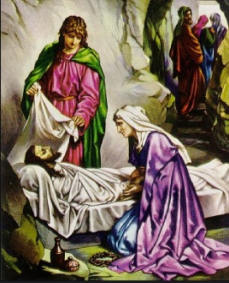
Just a few more days to be filled with praise
Just a few more days to be filled with praise, And to tell the old, old story;
Then, when twilight falls, and my Savior calls, I shall go to Him in glory.
Just a few more years with their toil and tears, And the journey will be ended;
Then I’ll be with Him, where the tide of time With eternity is blended.
Though the hills be steep and the valleys deep, With no flowers my way adorning;
Though the night be lone and my rest a stone, Joy awaits me in the morning.
What a joy ’twill be when I wake to see Him for Whom my heart is burning!
Nevermore to sigh, nevermore to die, For that day my heart is yearning.
Refrain
I’ll exchange my cross for a starry crown, Where the gates swing outward never;
At His feet I’ll lay every burden down, And with Jesus reign forever.

